Slide 1
BCVUMPS-3Dising

Slide 2
Contents
Variational Uniform MPS
(VUMPS)
contract
2D classical ising model
PEPS
3D classical ising model
big cell
Big Cell VUMPS
(BCVUMPS)

Slide 3
VUMPS-2Dising

Slide 4
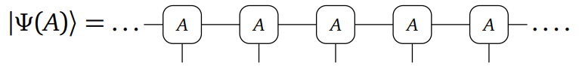
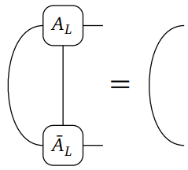
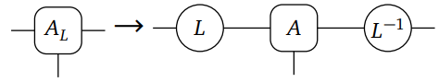
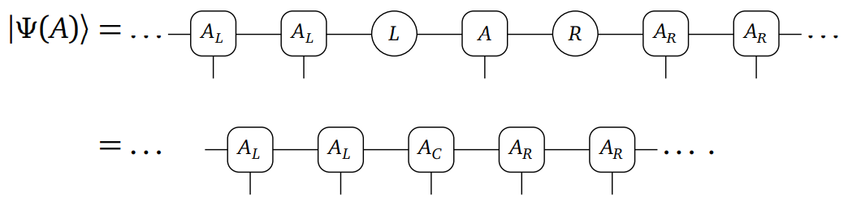
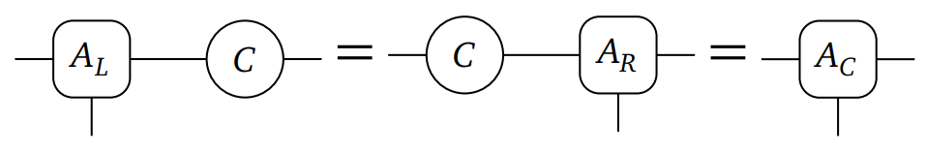
orthonormal form or mixed gauge
UMPS
Gauge transform
orthonormal form
C = LR

Slide 5
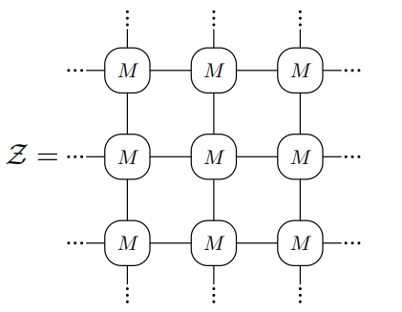
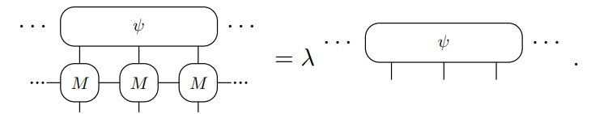
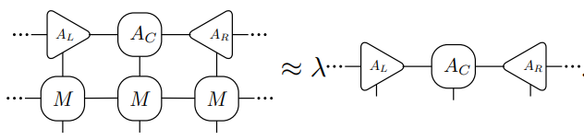
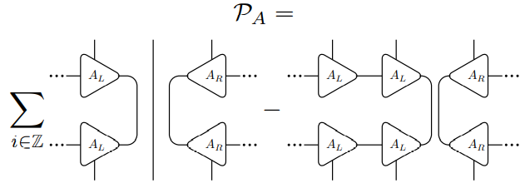
2D ising contract
orthonormal form
Project to tangent space

Slide 6
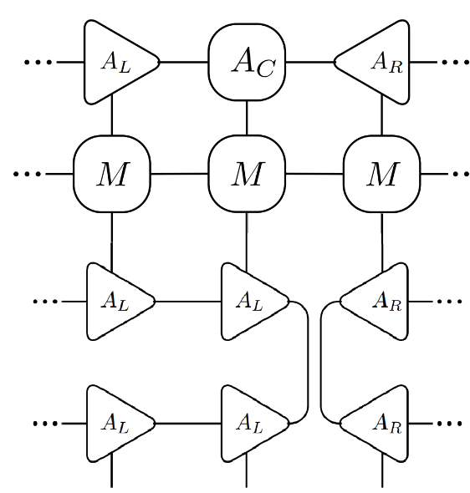
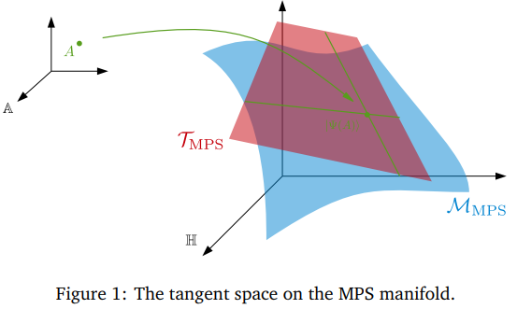
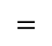
Project to tangent space
$$=$$

Slide 7
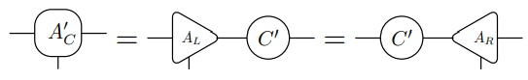
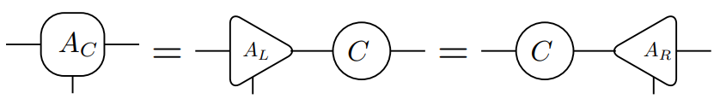
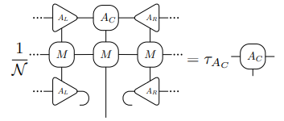
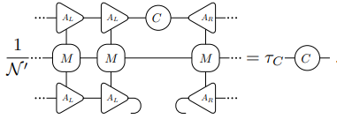
VUMPS fixed point
Unique C gauge transform

Slide 8
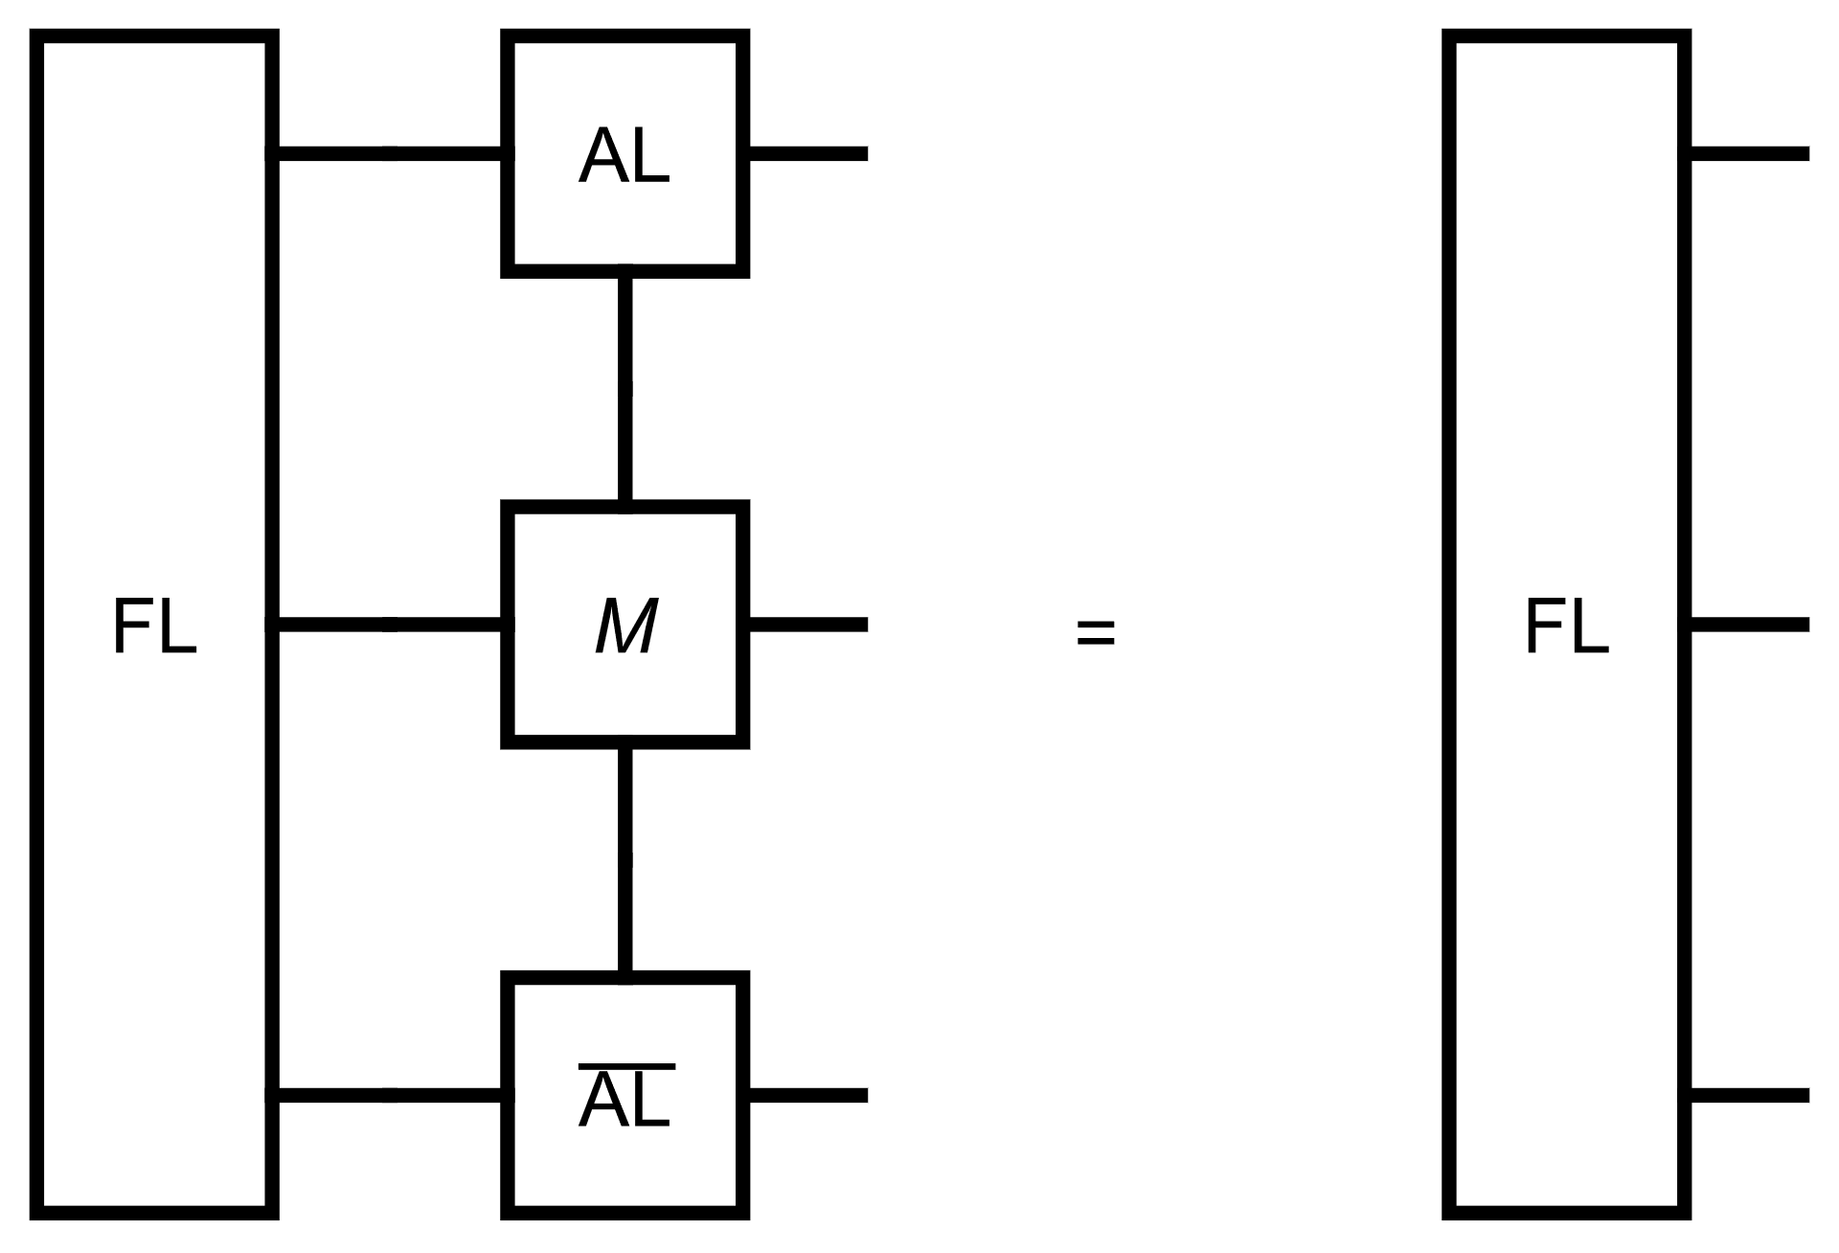
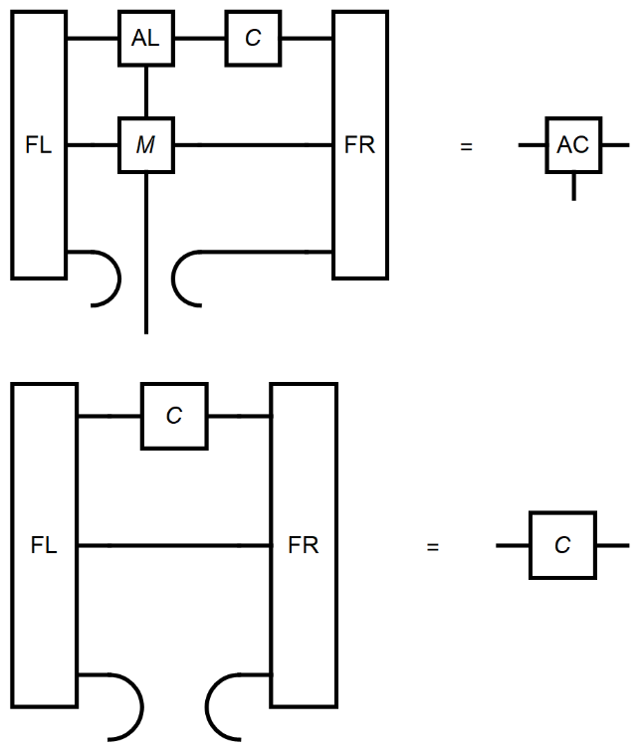
Environment
Left and right environment

Slide 9

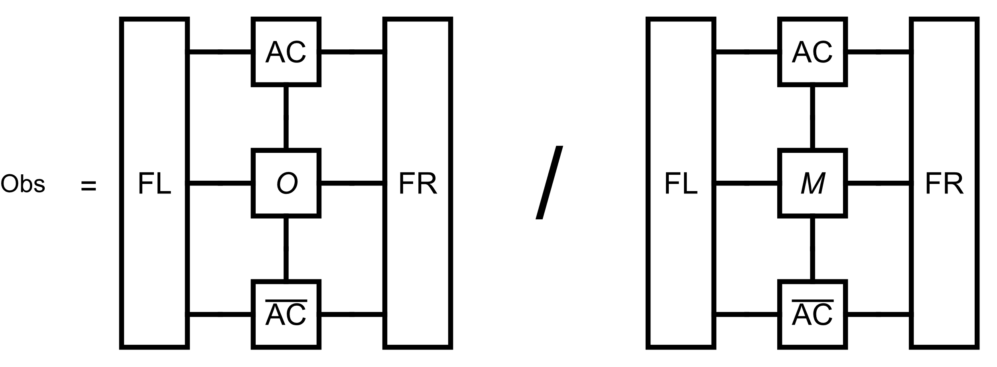
VUMPS-algorithm
# Initial orthonormal form MPS
M = classical2Disingmpo(β; J = 1.0, h = 0.)
AL,C = leftorth (A)
AR = rightorth (AL,C)
while error(AC,FL,FR,M) > tol_error
# Get environment
FL = leftenv(AL, M)
FR = rightenv(AR, M)
# Get orthonormal form
AC, C = vumpsstep(AL, C, AR, M, FL, FR)
# calculate observable
Obs = obser(O, AC, M, FL, FR)

Slide 10
Calculate other observable

Slide 11
VUMPS-3Dising

Slide 12
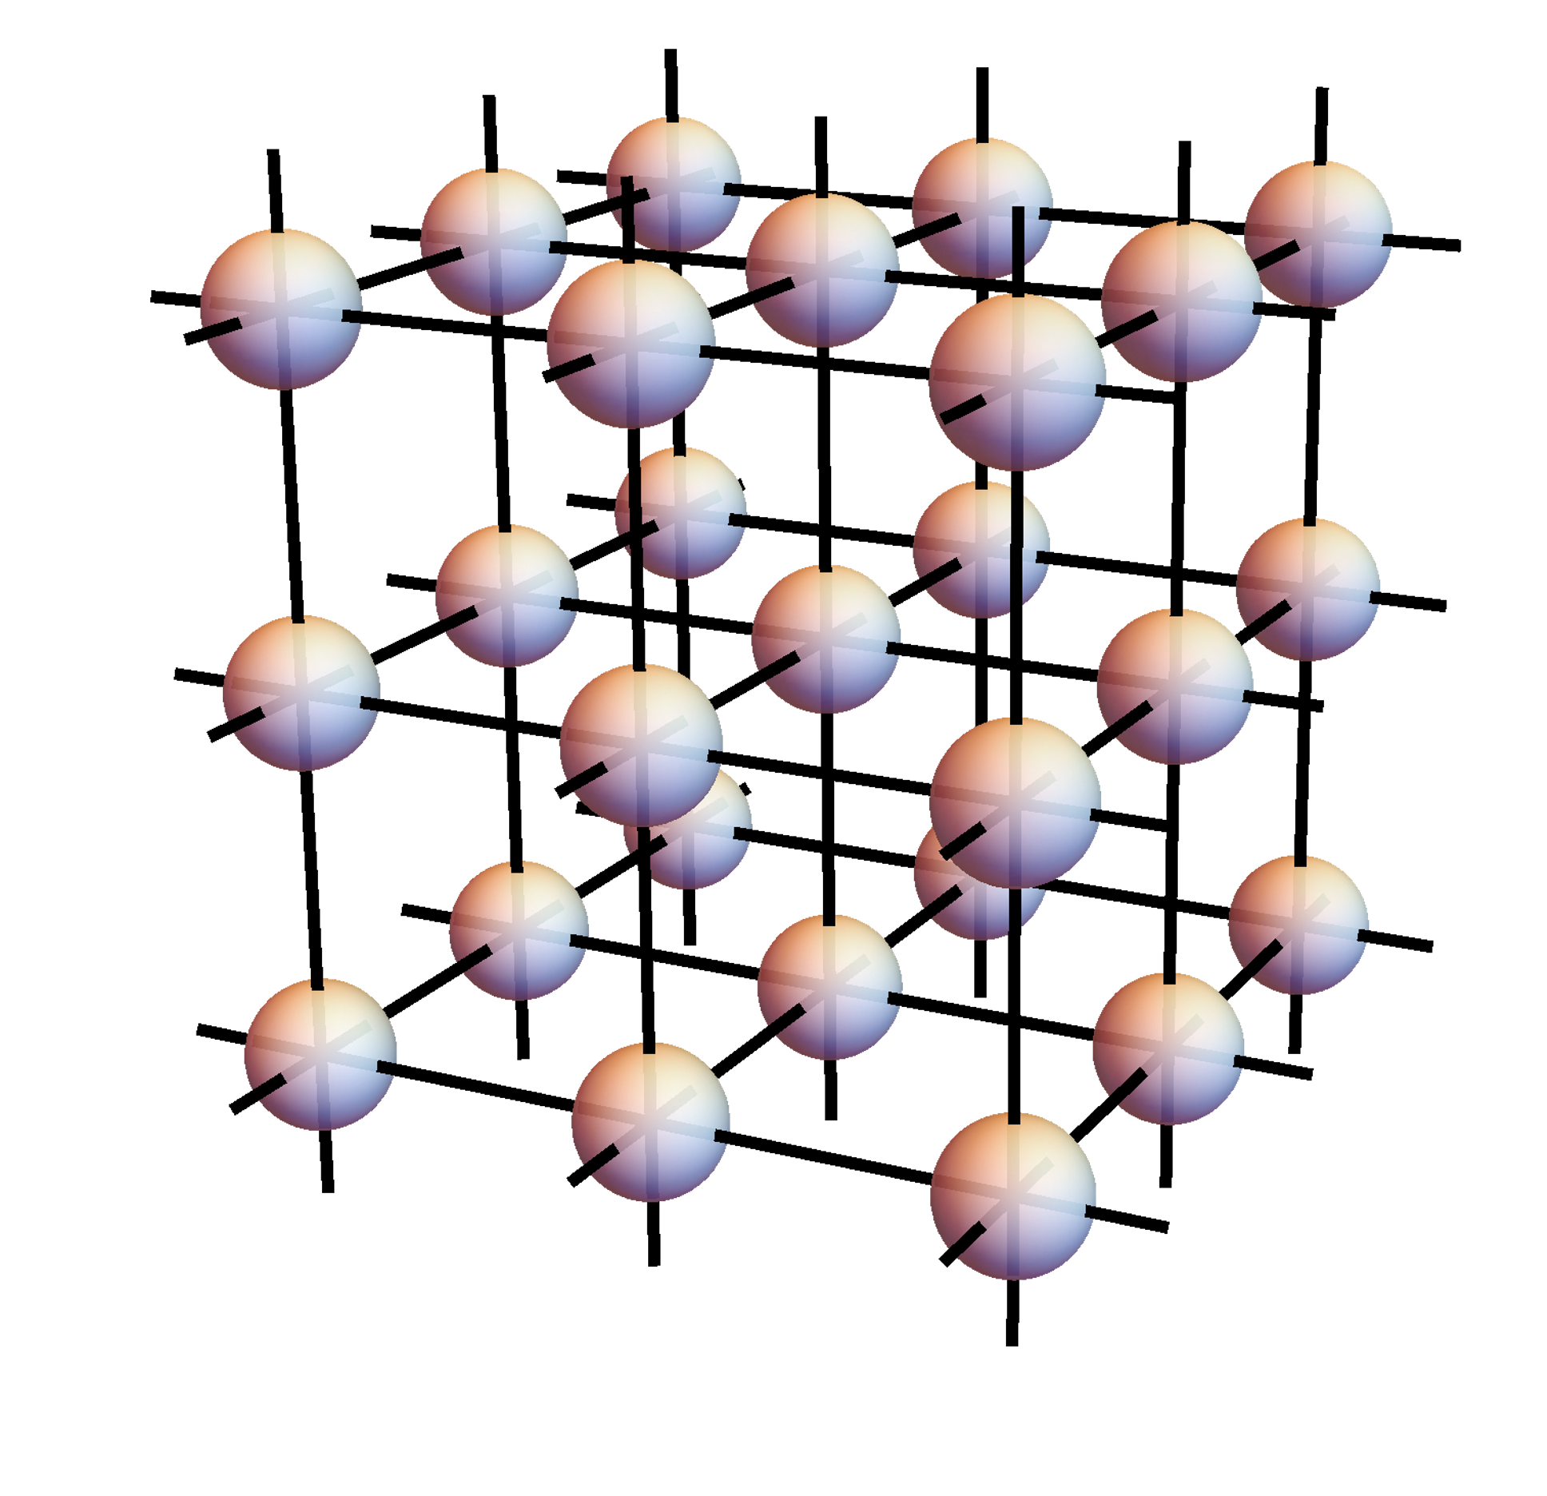
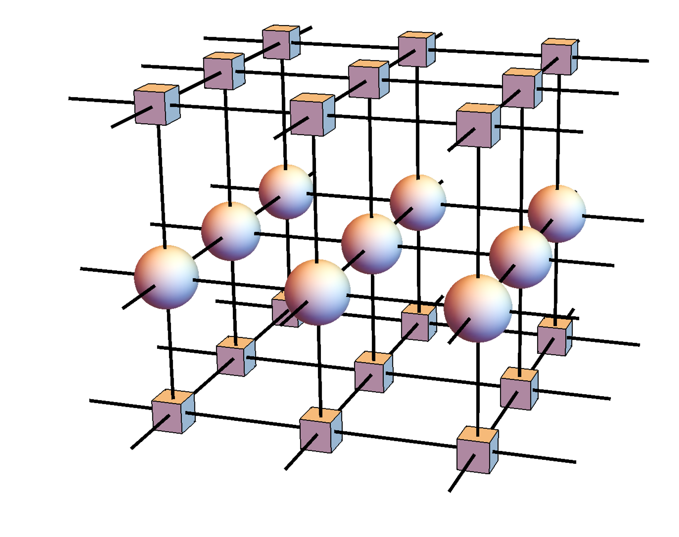
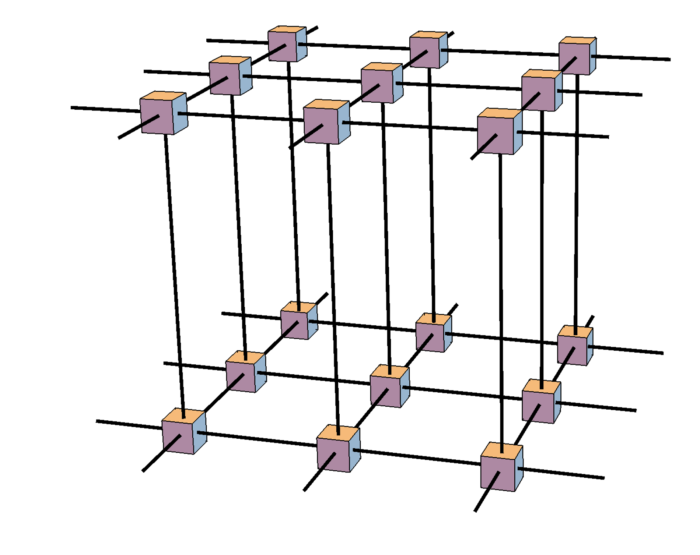
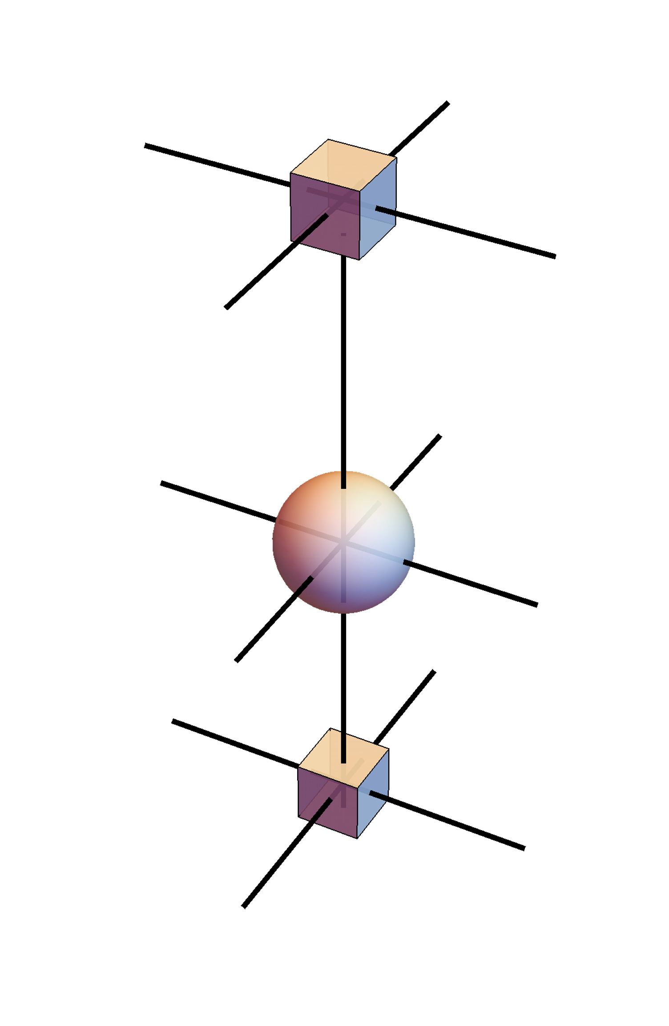
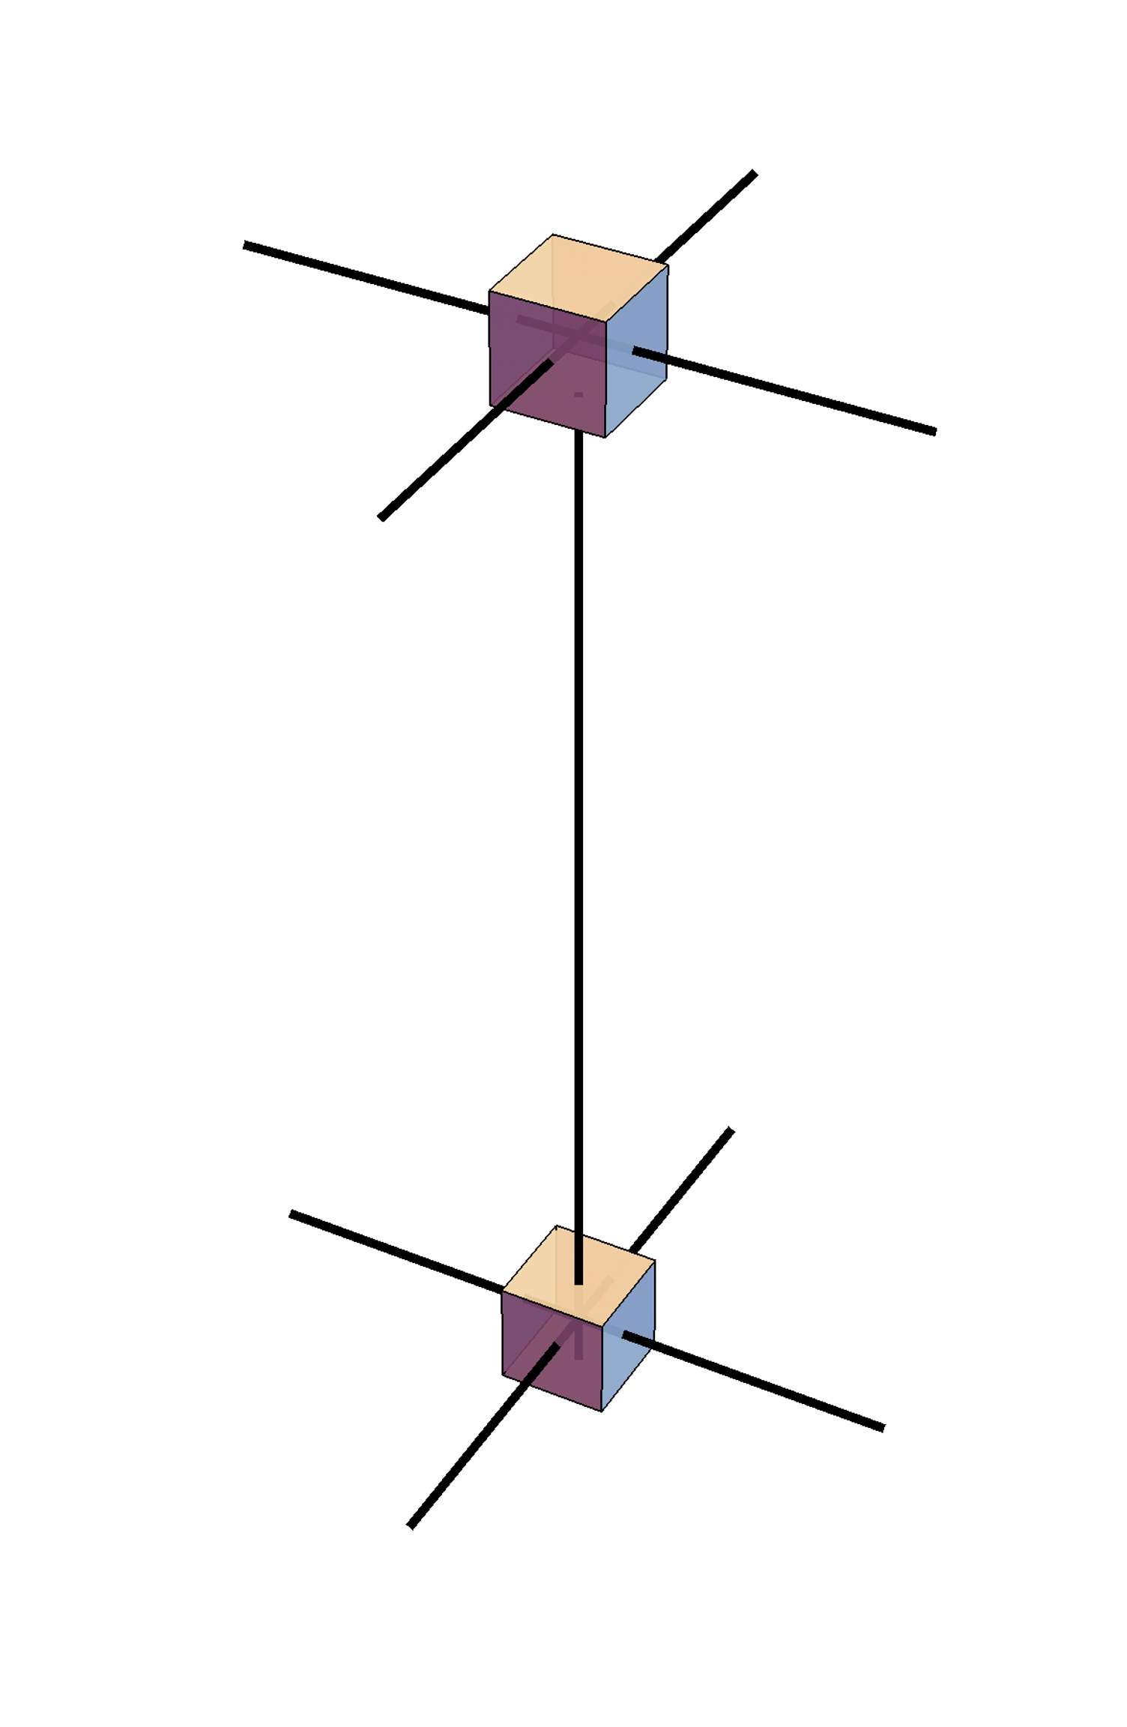
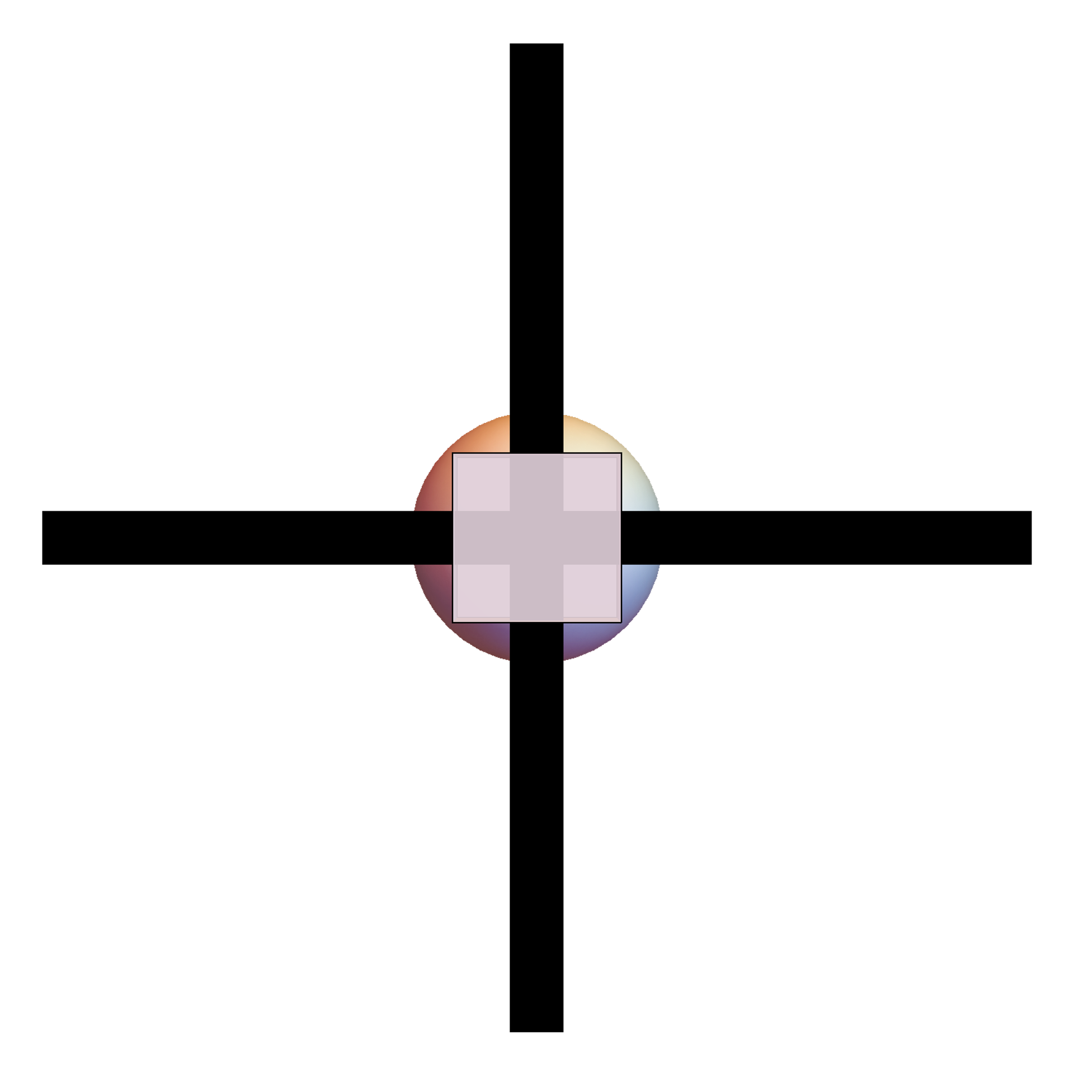
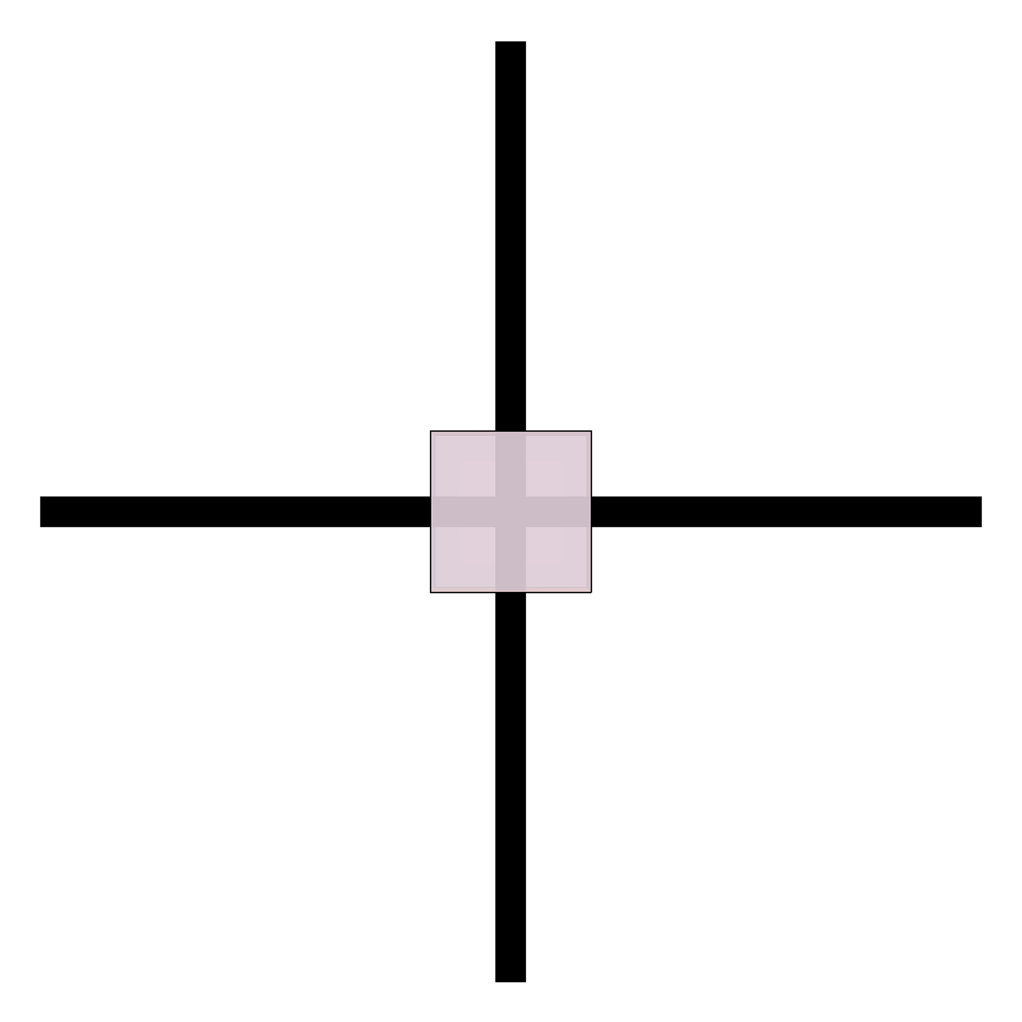

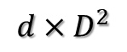
3D ising contract
PEPS
Z =
=
/
single
z =
A
D
D
$$d×D^{2}$$
$$D^{2}$$
contract to 2D
M
/
/
d
M1
M2
A
D
D

Slide 13
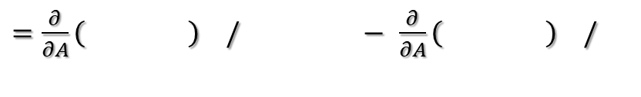
Gradient to single site
/
contract with VUMPS
M1
M2
/
Free energy for single site = $−\frac{1}{N}\log{Z}$ = $−\log{z}$ = $−\log{( )}$
Gradient = $−\frac{∂}{∂A}\log{z}$ =$−\frac{∂}{∂A}\left[−\log\left( \right)+\log\left( \right) \right]$
$=\frac{∂}{∂A}\left( \right) /$ $−$ $\frac{∂}{∂A}\left( \right) /$

Slide 14
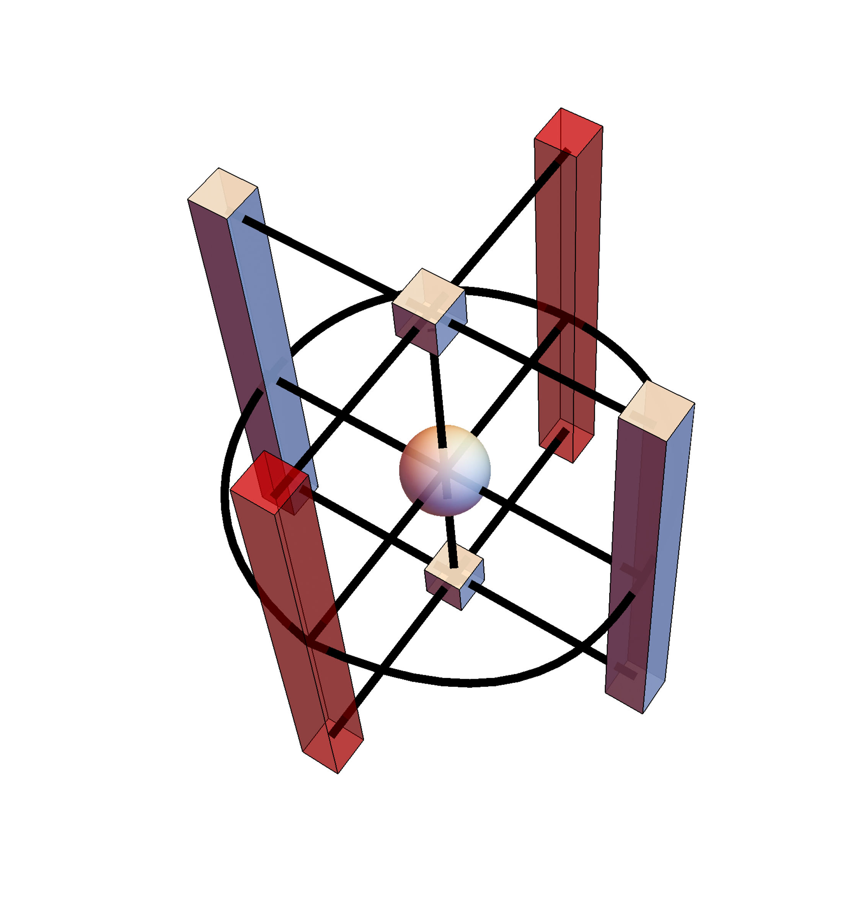
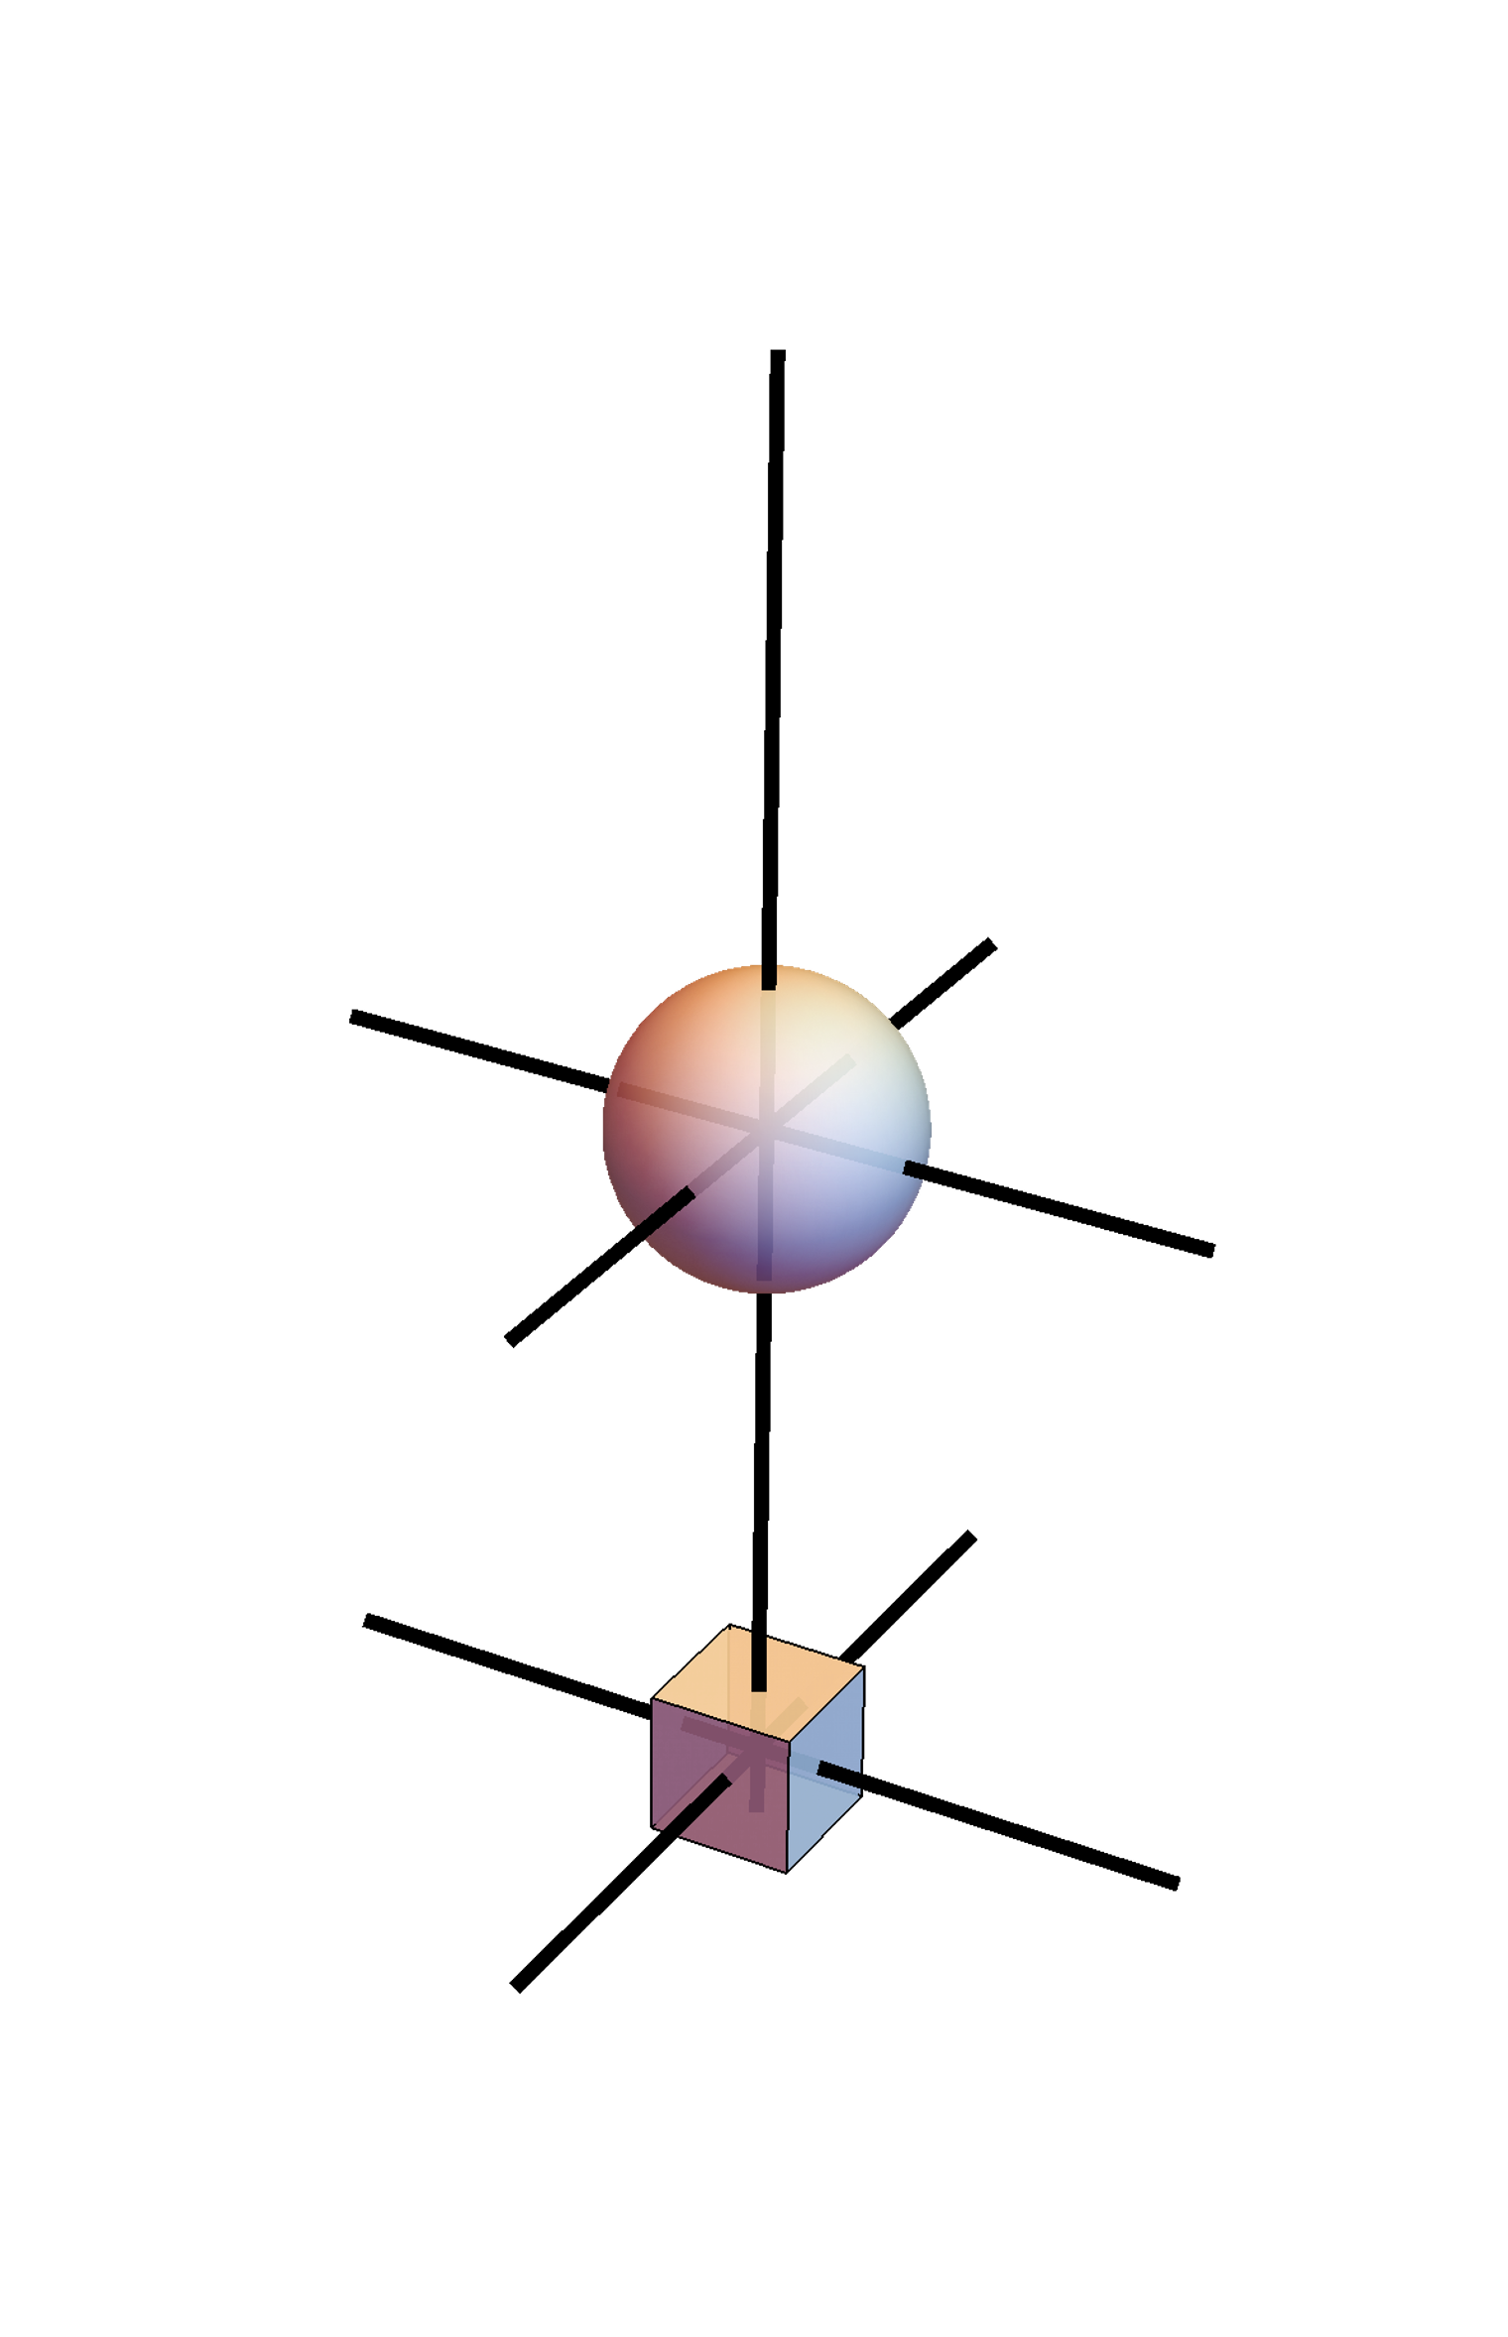
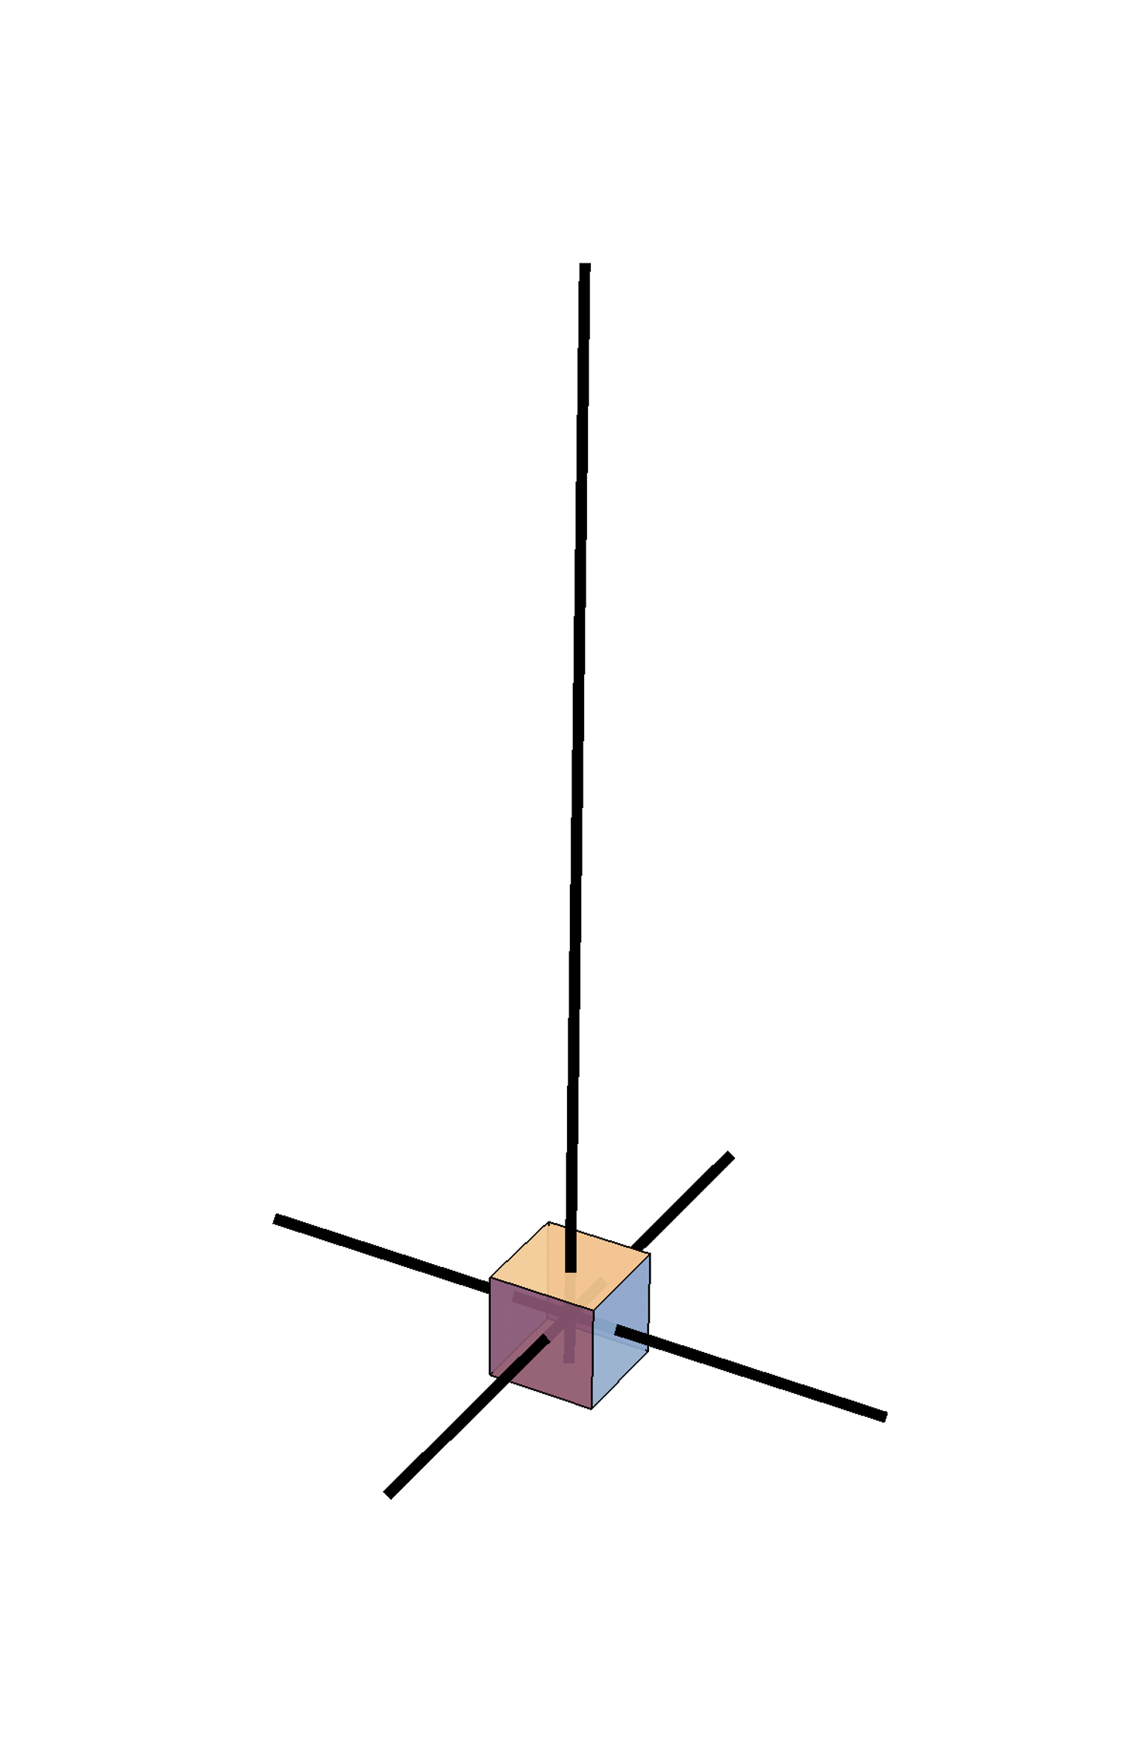
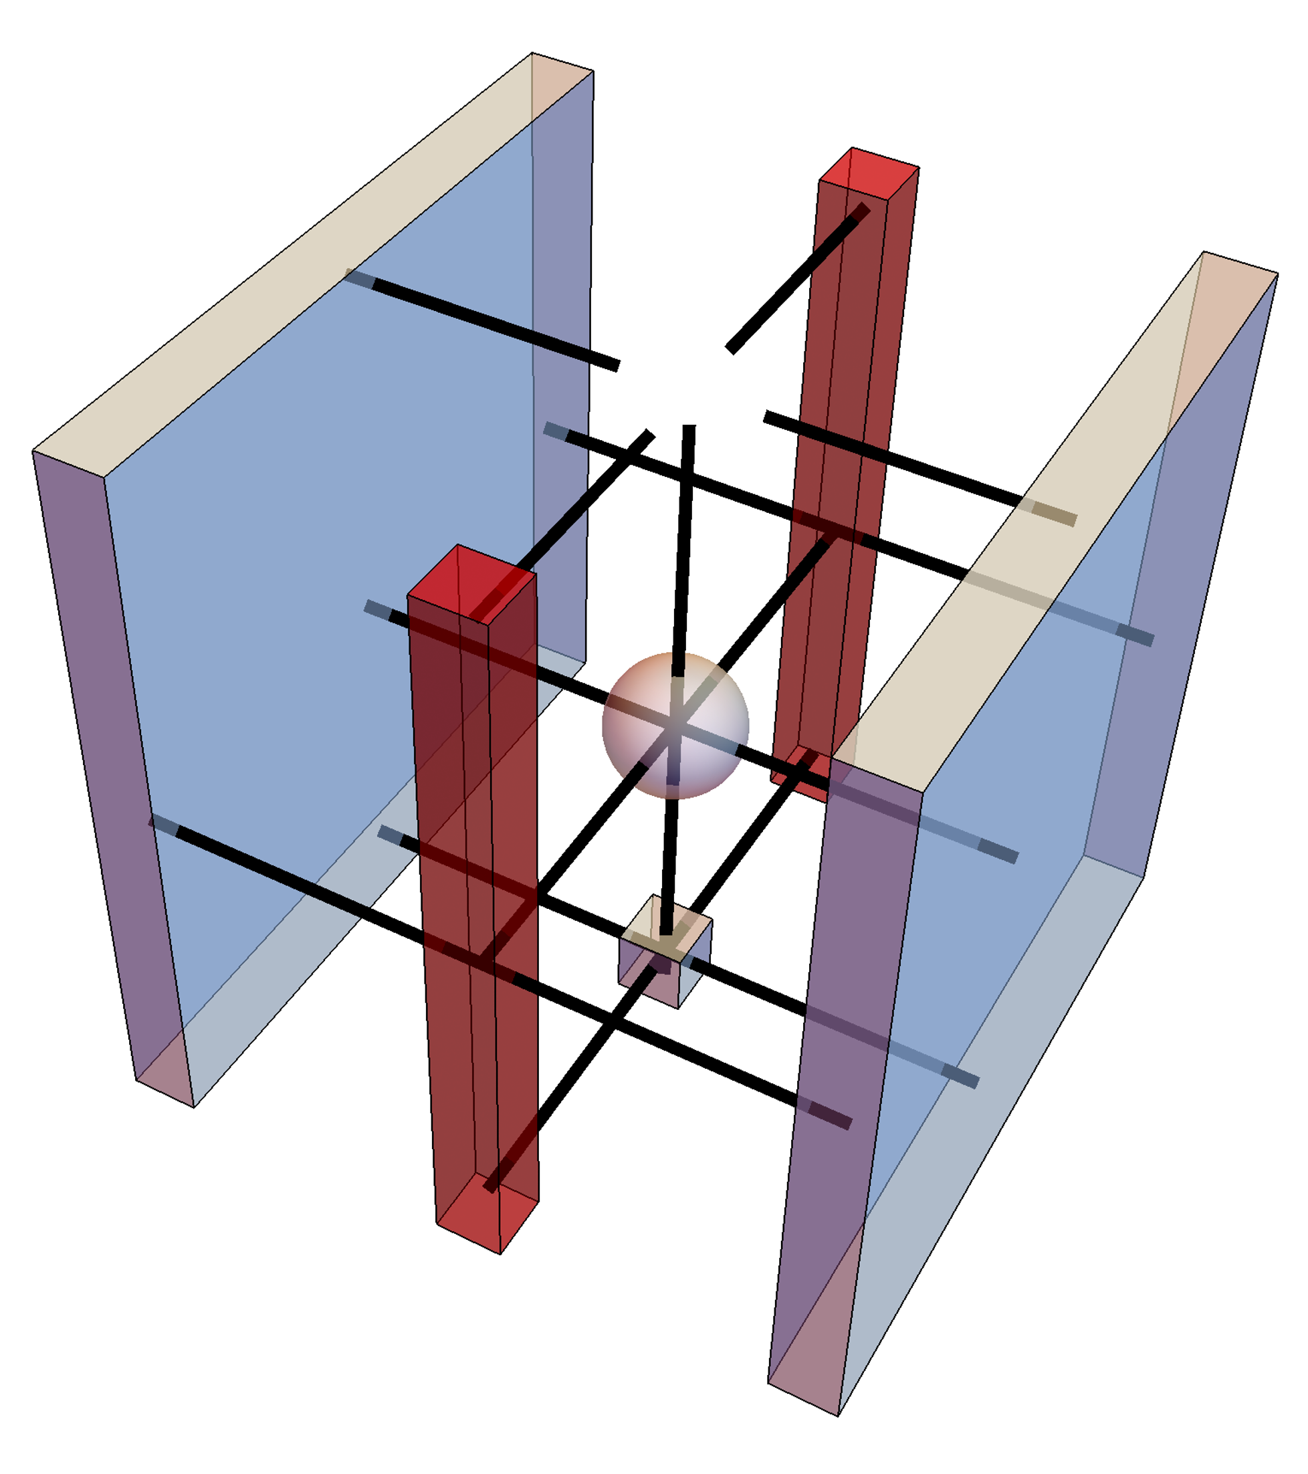
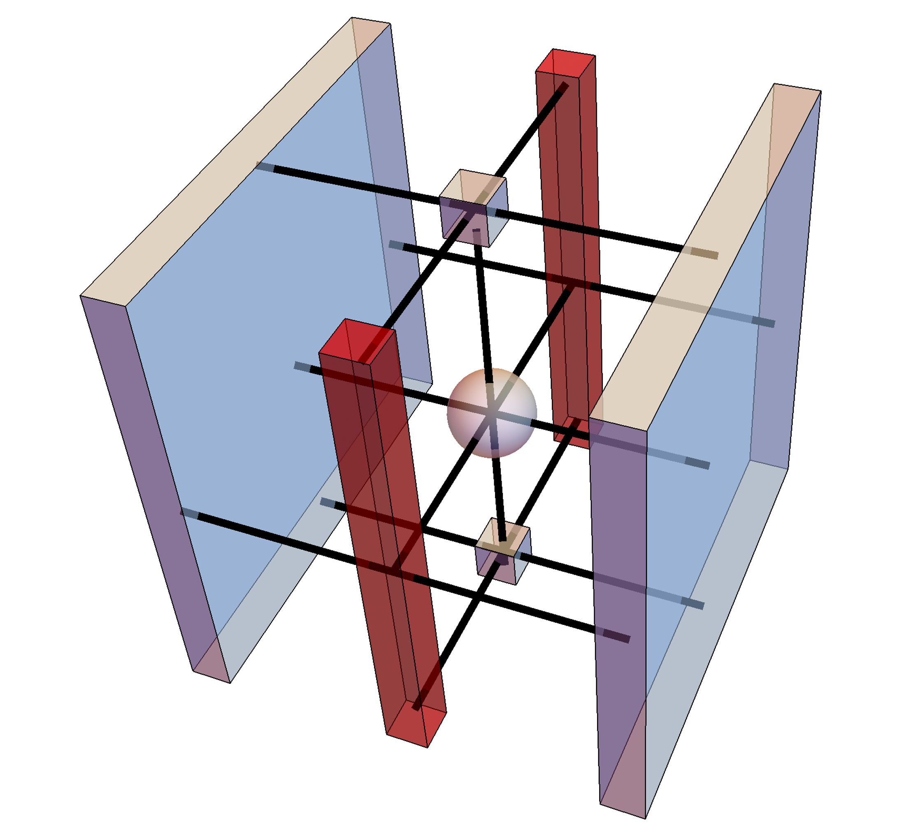
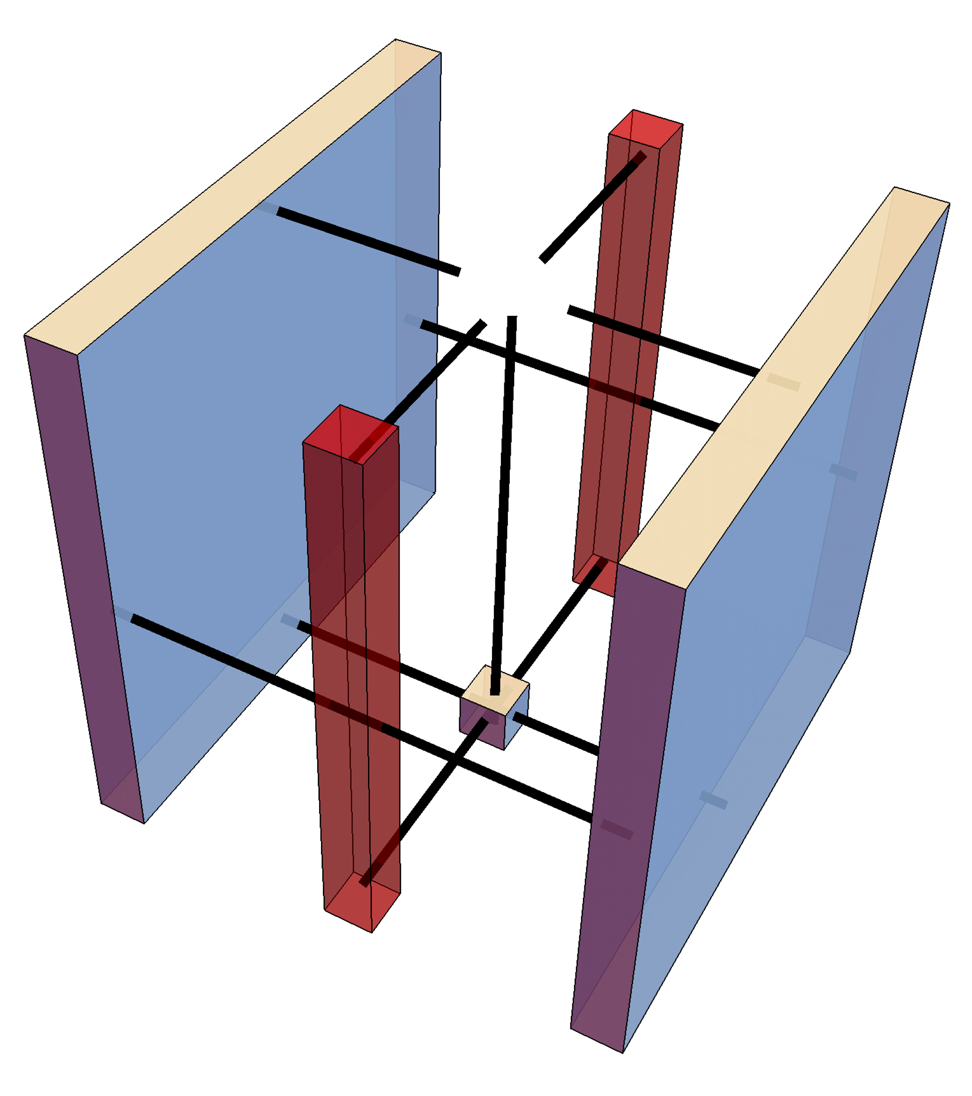
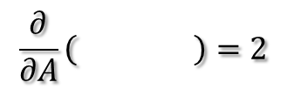
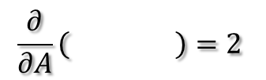
Gradient to and
$$\frac{∂}{∂A}\left( \right)=2$$
$$\frac{∂}{∂A}\left( \right)=2$$
3D view
add envir

Slide 15
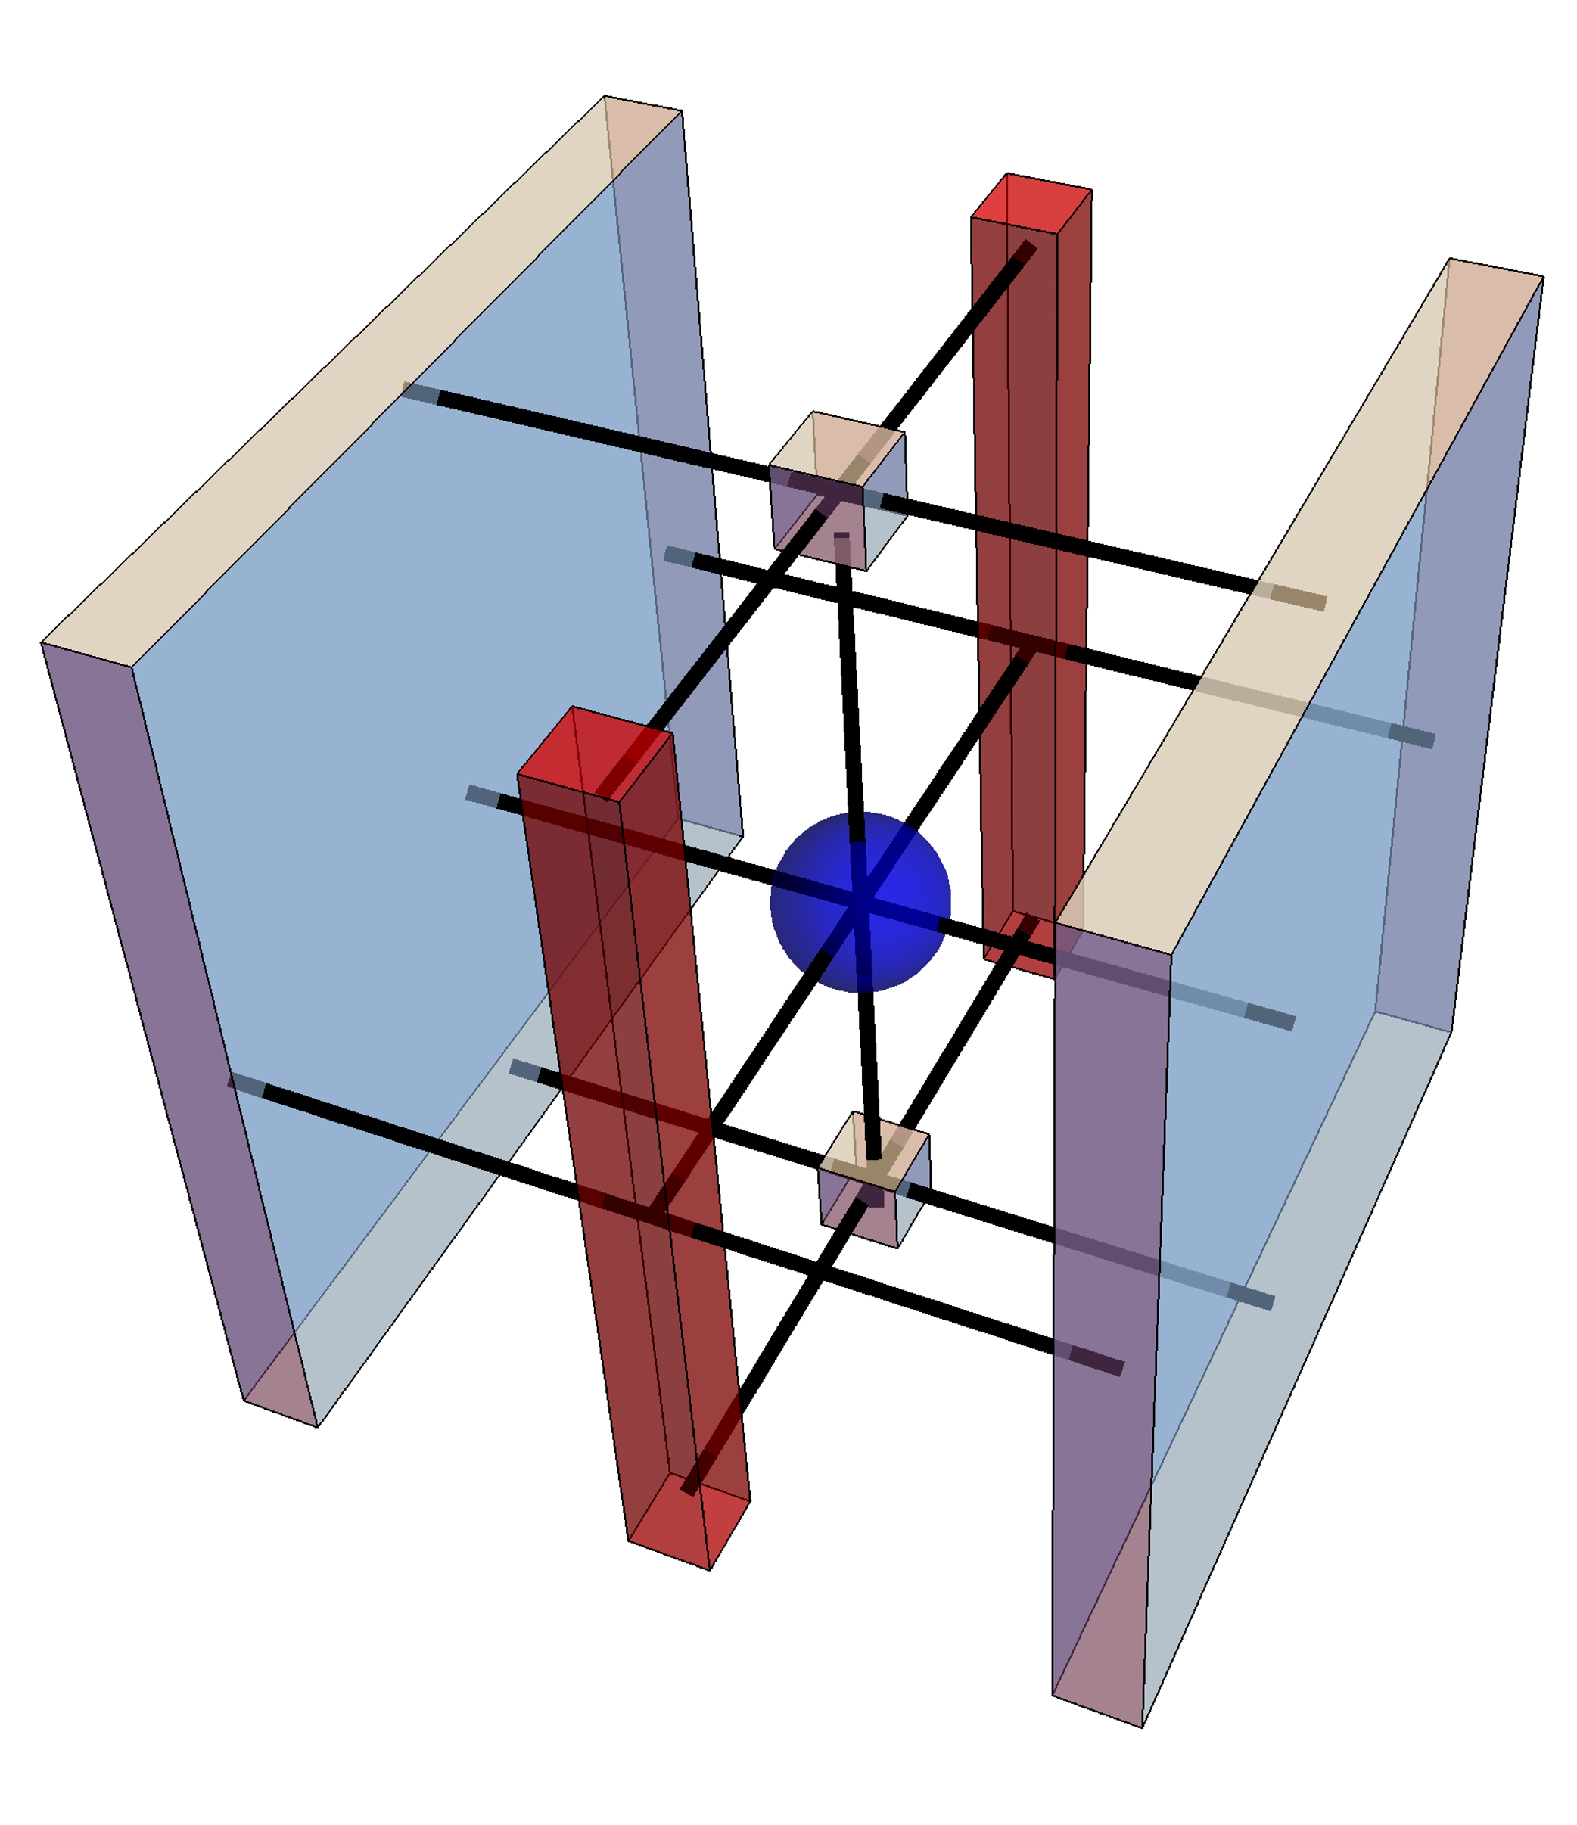
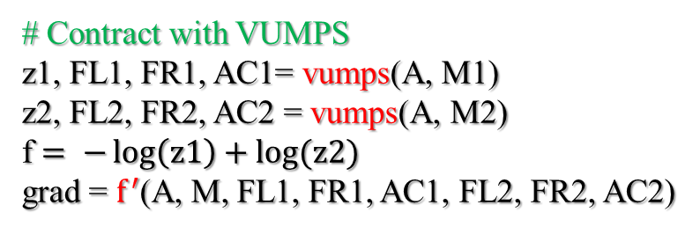
3Dising-algorithm
# Initial uniform form PEPS
M = classical3Disingmpo(β; J = 1.0, h = 0.)
M1, M2 = build(A, M)
M1
M2
# Contract with VUMPS
z1, FL1, FR1, AC1= vumps(A, M1)
z2, FL2, FR2, AC2 = vumps(A, M2)
f $= −\log\left(z1\right)+log⁡(z2)$
grad = $f^{′}$(A, M, FL1, FR1, AC1, FL2, FR2, AC2)
# Optimize free energy
f = optimizer (f, grad)
/
# calculate observable
Obs = obser(A, O, M, FL2, FR2, AC2)

Slide 16
Big Cell PEPS

Slide 17
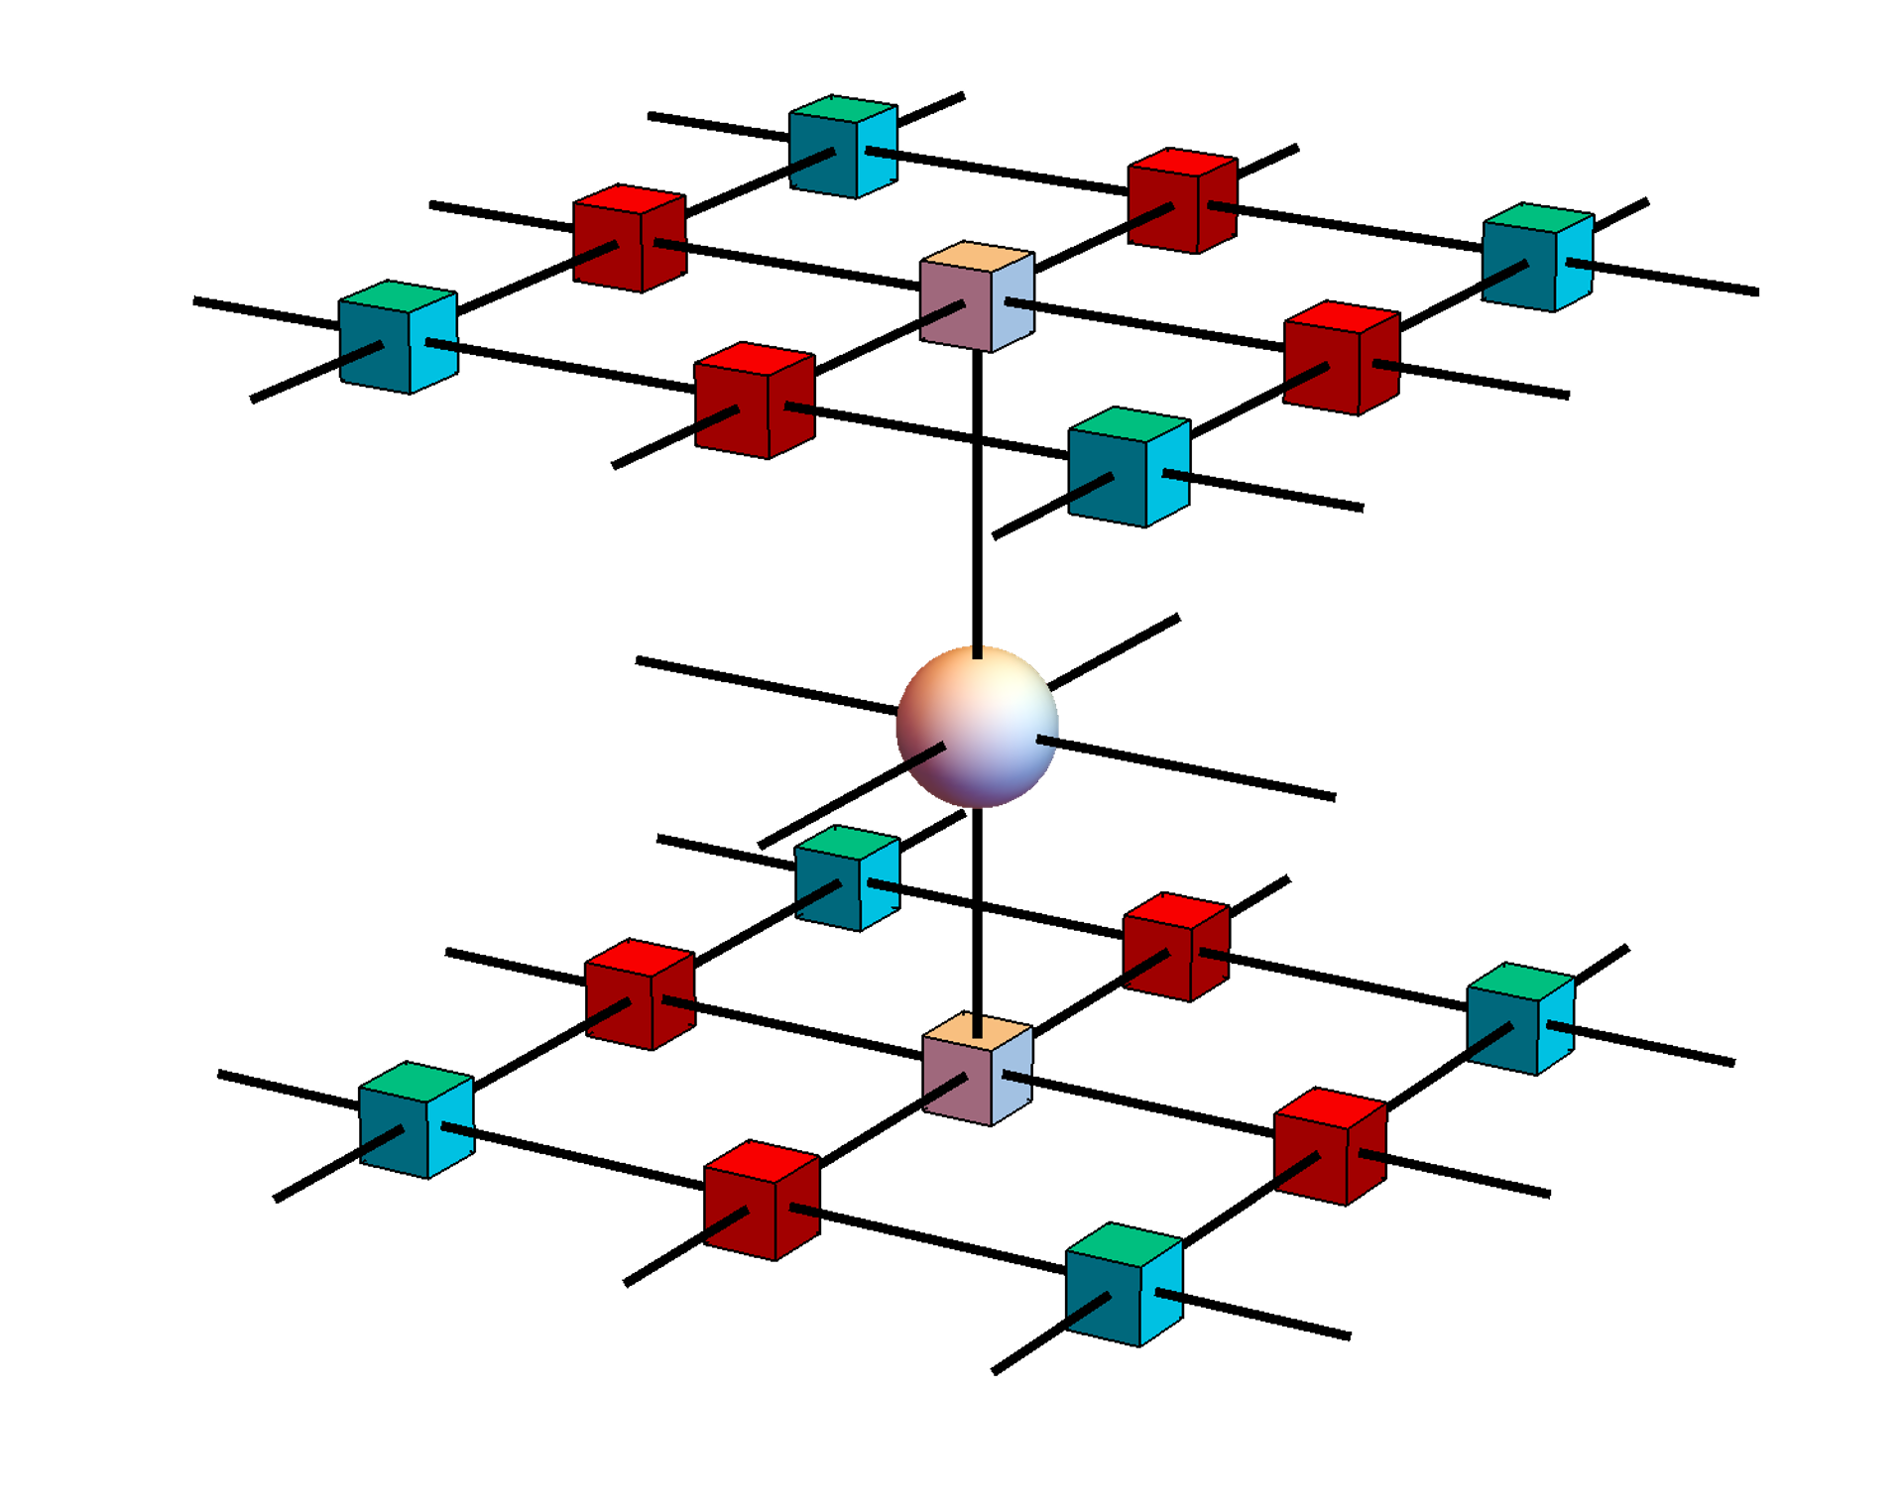
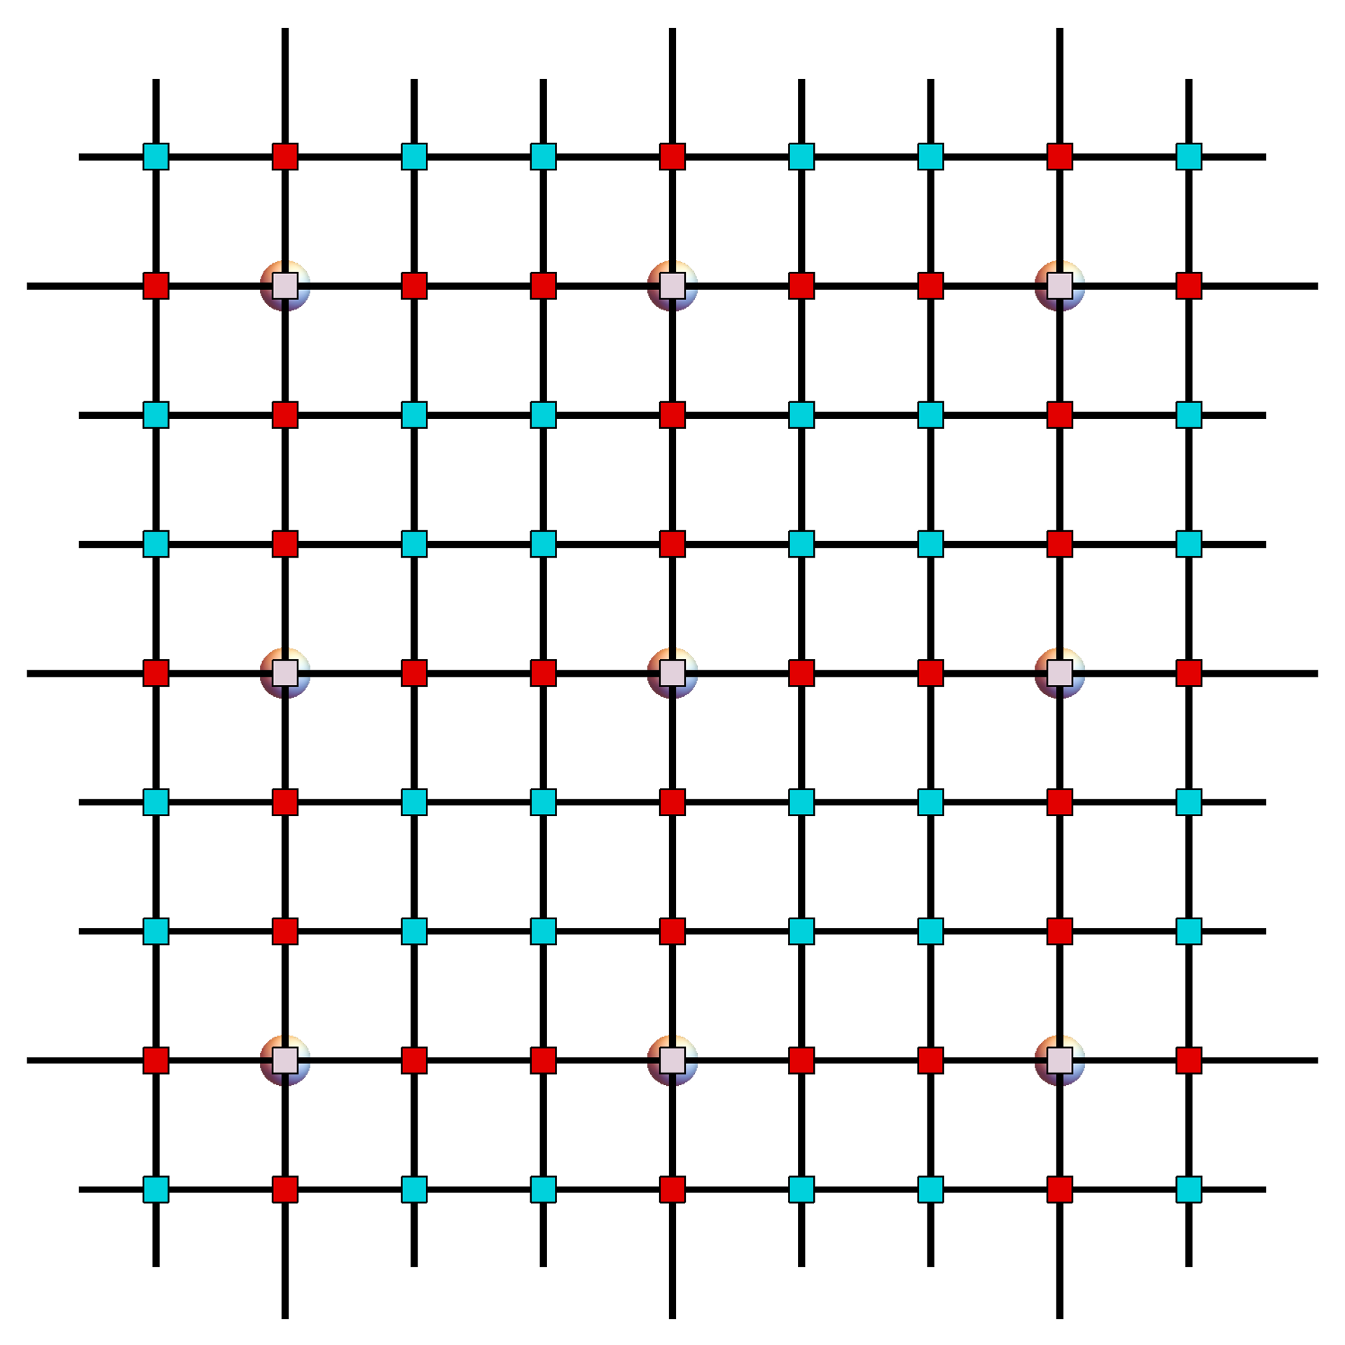
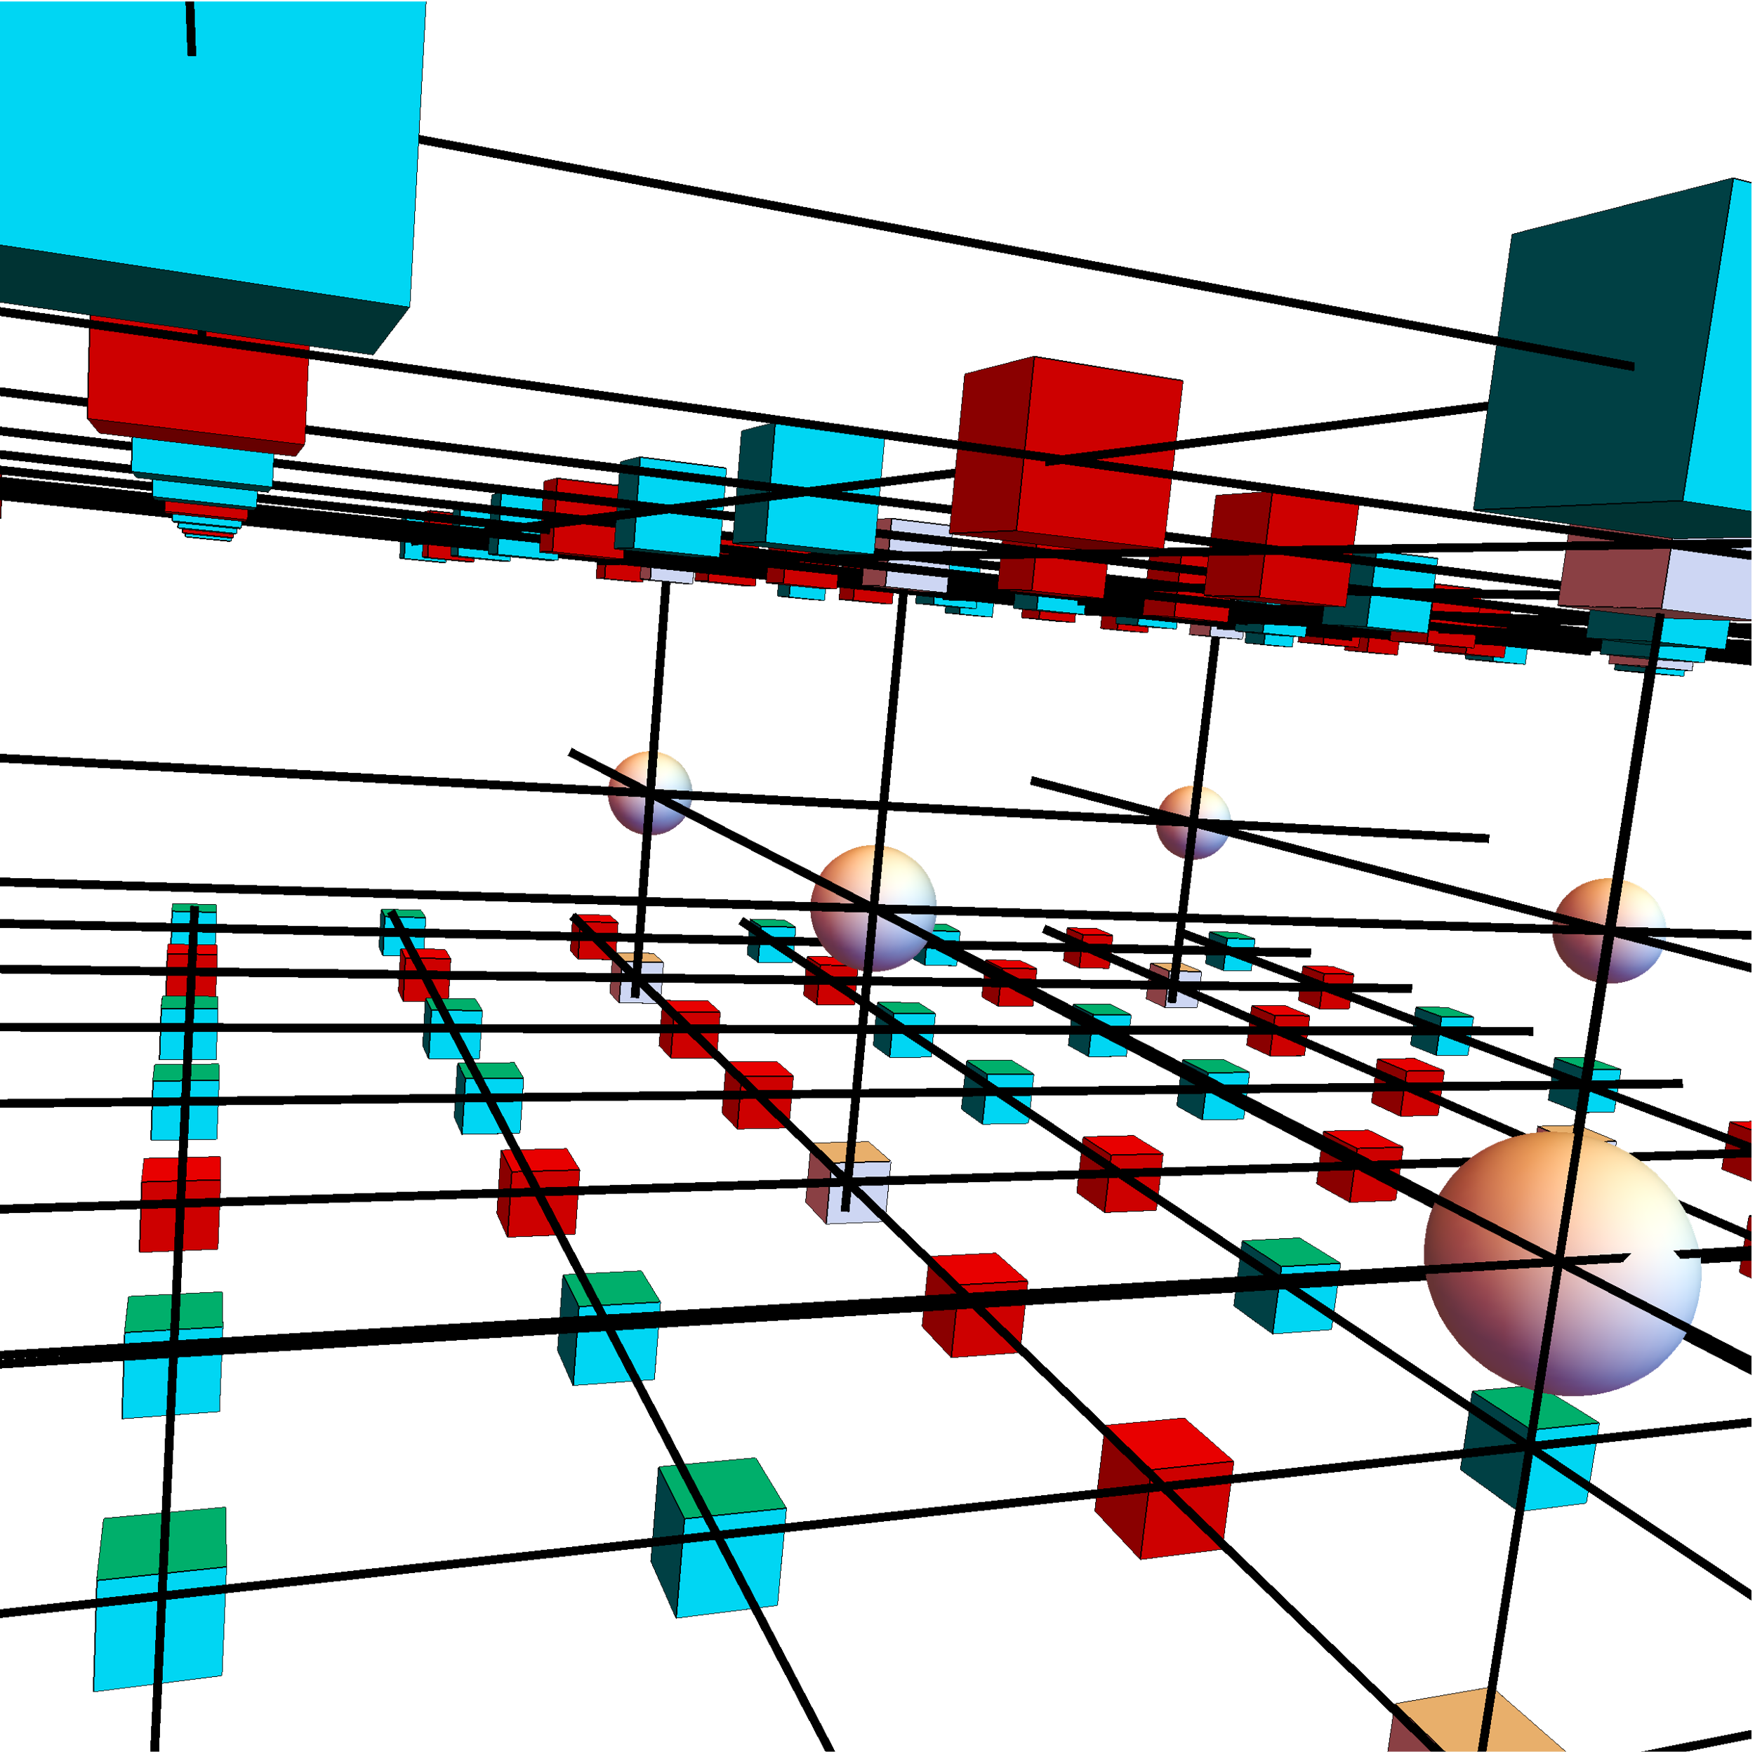

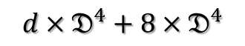

Big Cell
$$D=𝔇^{3}$$
$$d×D^{4}$$
$$d×𝔇^{4}+8×𝔇^{4}$$
Add edge and corner PEPS

Slide 18
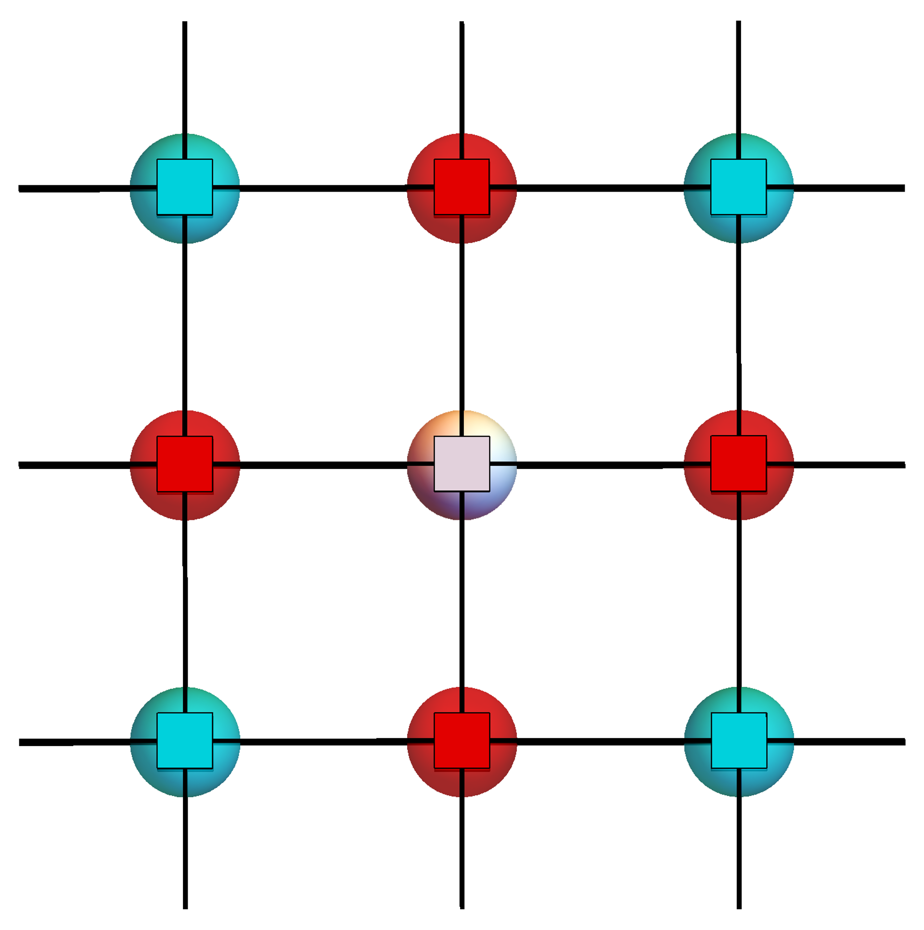
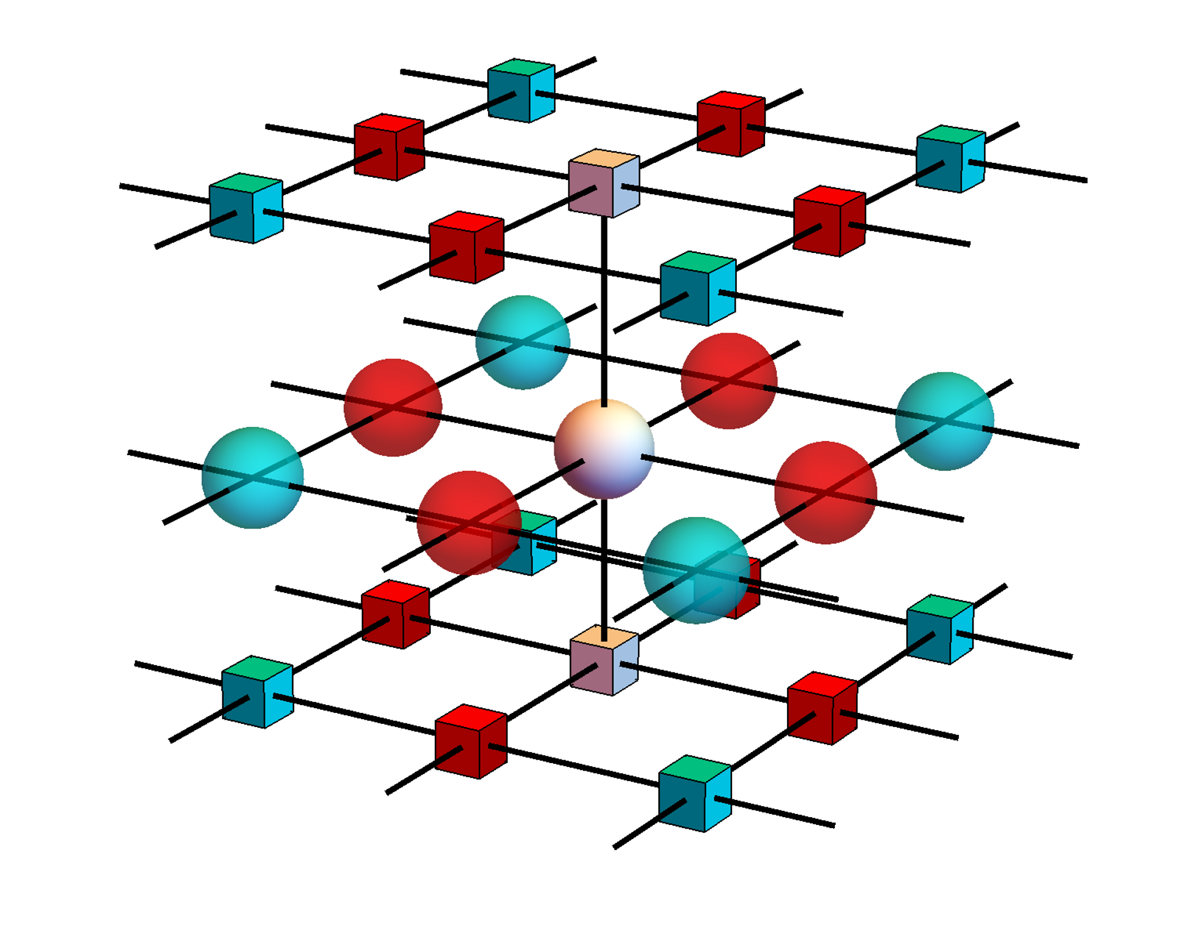
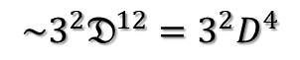
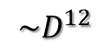
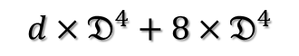
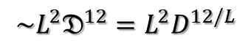

Big Cell
$$D=𝔇^{3}$$
$$d×D^{4}$$
$$d×𝔇^{4}+8×𝔇^{4}$$
Add edge and corner PEPS
$${\sim D}^{12}$$
$${\sim 3^{2}𝔇}^{12}=3^{2}D^{4}$$
get 3 types M
$${\sim L^{2}𝔇}^{12}=L^{2}D^{12/L}$$
Add δ tensor
M2
M3
M1
contract to 2D

Slide 19
Big Cell VUMPS

Slide 20
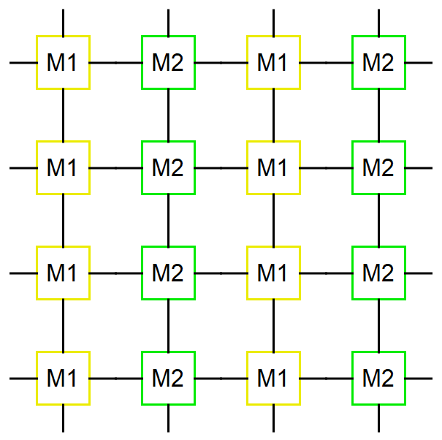
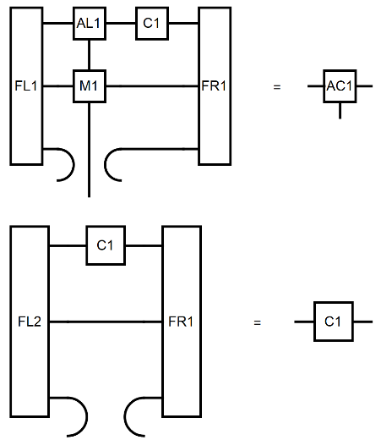


1$×$2 & 2$×$1
lattice
vumpsstep
environment

Slide 21



1$×$2 & 2$×$1
lattice
vumpsstep
environment

Slide 22

Environment for every $M_{ij}$
Obs
O
/

Slide 23



BCVUMPS-algorithm
# Initial orthonormal form MPS
$M_{ij}$ = mpo(params)
${AL}_{ij},C_{ij}$= leftorth ($A_{ij}$)
${AR}_{ij}$ = rightorth (${AL}_{ij},C_{ij}$)
while error(AC,FL,FR,M) > tol_error
# Get environment
AL[i, j] = leftenv(AL[i , :], M [i , :])
AR[i, j]= rightenv(AR[i , :], M [i , :])
# Get orthonormal form
AC[i, j], C[i, j] = vumpsstep(AL[:, j], C[:, j], AR[:, j], M[:, j], FL[:, j], FR[:, j])
# calculate observable
Obs = obser(O, AC, M, FL, FR)

Slide 24



verify

Slide 25







Consider observable for 3$×$1 Cell
/
Obs1 =
/
Obs2 =
/
Obs3 =

Slide 26



expand
Must be Hermitian!

Slide 27


Correct observable
/
Obs1 =

Slide 28
BCVUMPS-3Dising

Slide 29





1$×$1 3Dising observable
lnZ
Get min lnZ

Slide 30




1$×$1 Gradient descent
-lnZ
gradnorm
magnetization

Slide 31




$1×3$ 3Dising observable

Slide 32


$1×3$Gradient descent
1x1 D=2 -0.777407
1.545e-05
1x3 D=2 -0.777422
1.758e-05
1x1 D=4 -0.777440

Slide 33


$3×3$quench
Calculate from a high temperature to avoid local minimum

Slide 34
Cheat initial
Edge and corner PEPS all set δ tensor，center PEPS set 1x1 cell tensor

Slide 35

To do
GPU
Bigger $χ$

